Slide 1
Student Electronic Portfolios Using Google Tools
Melody Paige
Monett R-1 Schools
mpaige@monettschools.org @melpaige

Slide 2
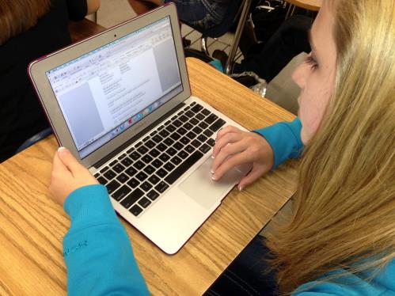
Why digital portfolios?
Student Electronic Portfolios Using Google Tools

Slide 3
Student Electronic Portfolios
Google Options:
Google Slides
Google Document
Blogger
Google Sites
Google Sheets
Student Electronic Portfolios Using Google Tools

Slide 4
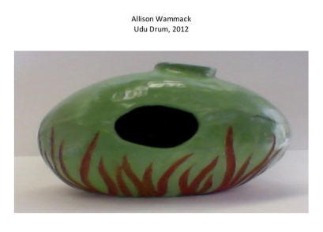
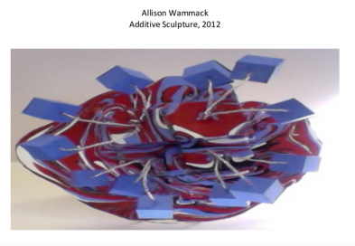
Google Slides
Student Example
Student Electronic Portfolios Using Google Tools

Slide 5
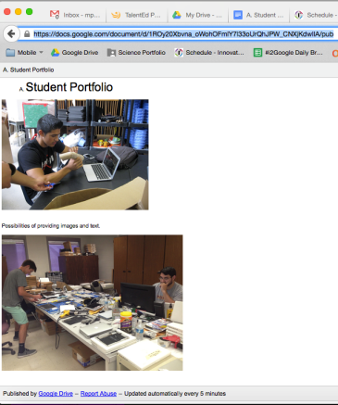
Google Document
Create a Google Document and Publish to the Web
Student Electronic Portfolios Using Google Tools

Slide 6
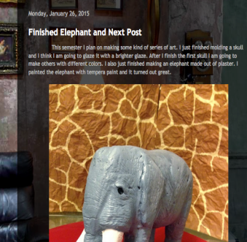
Blogger
Student Example -- Art, Government, and English III blogs
Methods for teacher to organize student blogs:
Teacher Art Example: create a Google Spreadsheet
Teacher Art Example: create a Google Document
A Glossary of Blogging Terminology
https://app.box.com/s/th9rq1nr6jav78r8c55frafw8hh09lav
Blogger Help Center
https://support.google.com/blogger/?hl=en#topic=3339243
Student Electronic Portfolios Using Google Tools

Slide 7
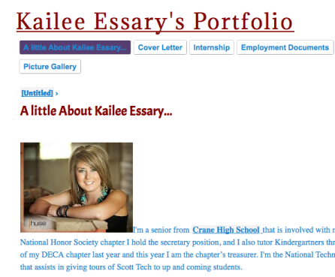
Google Sites
Student Examples:
Kailee
Breanna
Alexandra
Adding templates to the gallery
https://support.google.com/sites/answer/166291
Google Sites Help Center
https://support.google.com/sites/?hl=en#to
Student Electronic Portfolios Using Google Tools

Slide 8
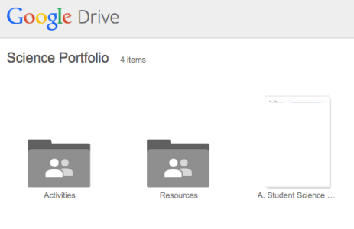
Google Spreadsheet
Using a traditional, paper three-ring science portfolio as an example, let’s start with a folder:
Google Folder
Student Electronic Portfolios Using Google Tools

Slide 9
Student Electronic Portfolios
You be the judge --
Google Slides
Google Document
Blogger
Google Sites
Google Sheets
Different ideas: adding web 2.0 tools like Thinglink.com, voki, animoto -- could use in Sheets, Sites, or Blogger
Student Electronic Portfolios Using Google Tools

