Slide 1
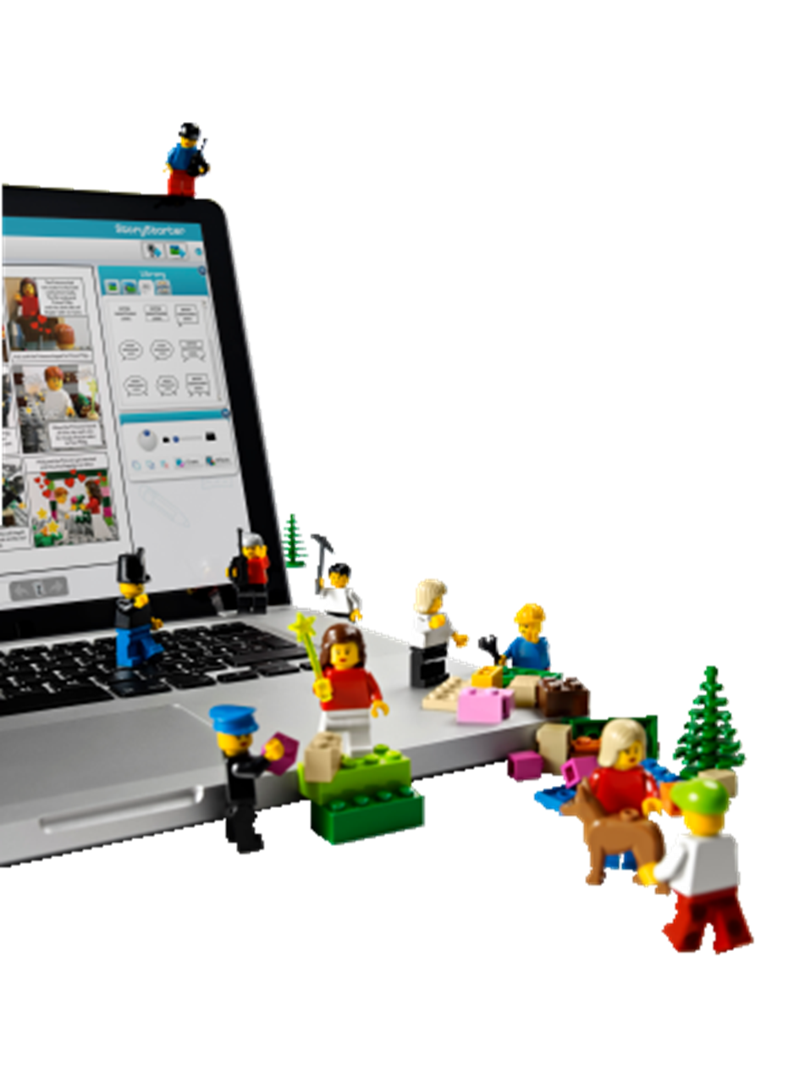
LEGO® Education StoryStarter

Slide 2
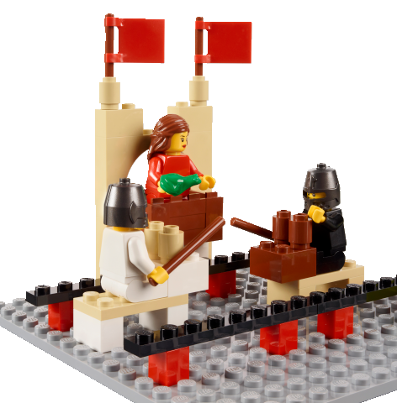
What is StoryStarter?
StoryStarter is an engaging and collaborative hands-on experience that boosts Language Arts skills and inspires every student in the classroom to create, comprehend, and communicate stories.
Notes:
Leshia

Slide 3
What does it look like?
Notes:
Gitte

Slide 4
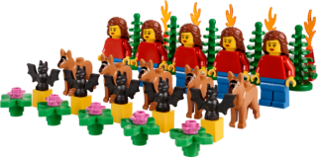
StoryStarter Core Set
1,144 elements delivered in a sturdy storage box
Assorted characters, animals, accessories, iconic elements and basic bricks. All elements x5.
5 building plates for creating story structures
1 building plate to build the spinner
2 spinner cards to create a spinner (Category, Setting, Time & Mood)
2 sorting trays
Sticker sheet for classroom management
- Characters, Props, Setting, Details, Scenes
Element overview
Notes:
Gitte

Slide 5
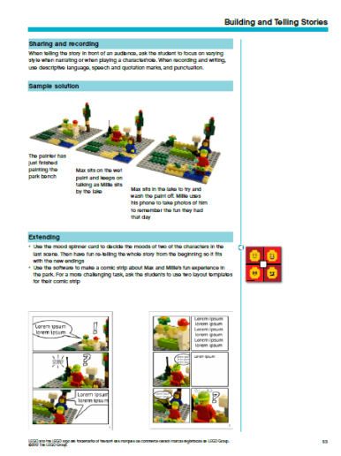
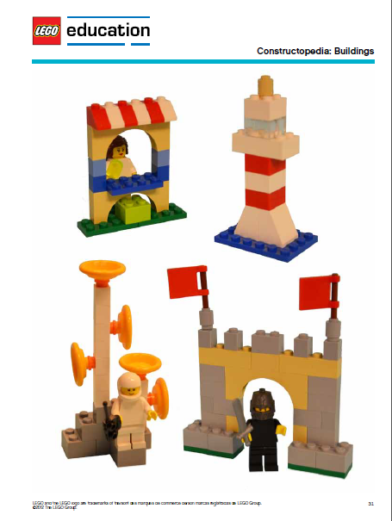
StoryStarter Curriculum Pack
Comprehensive material for the teacher including:
Curriculum Grid
Rubric Sample
Description and Guide to StoryVisualizer Software and App
24 differentiated Lesson Ideas
Activities all explicitly correlated to Common Core Standards
Tips & Tricks
FAQ
Notes:
Gitte

Slide 6
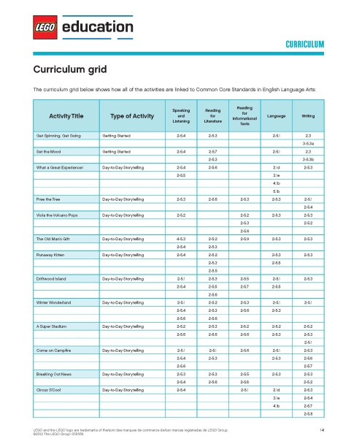
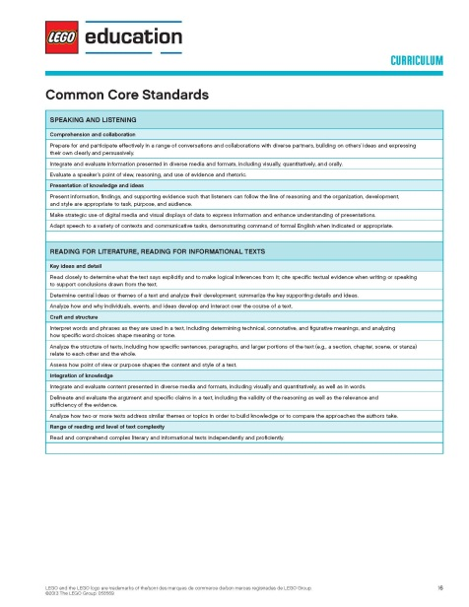
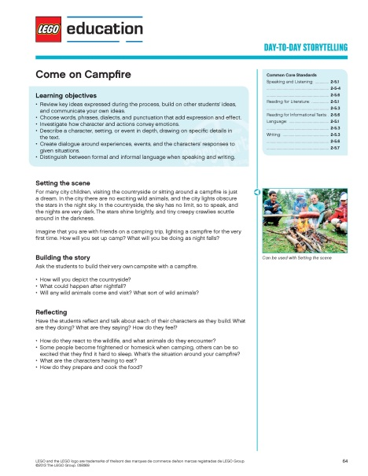
Curriculum Relevance
All 24 activities have been correlated to the English Language Arts Common Core State Standards for grades 2-5. Each activity has been tied to the parent standards in the following areas :
Speaking and Listening
Reading for Literature
Reading for Informational Text
Language
Writing
The curriculum pack contains four types of activities:
Getting Started
Day-to-day Storytelling
Building and Telling Stories
Analyzing and Retelling Stories

Slide 7
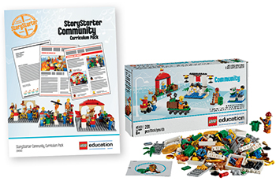
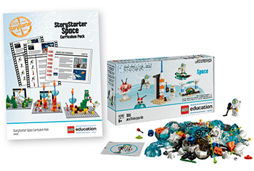
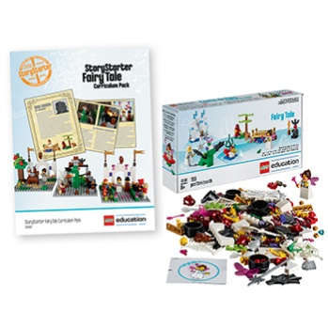
Solutions to Explore More Genres
Community Expansion
Space Expansion
Fairy Tale Expansion
Explore community and culture while learning about roles and responsibilities, community systems, guidelines, social behavior, and communication
Highlights real-world relevance by asking students to read informational texts and communicate their learning to others
Conduct research and interpret findings allowing students to delve into various types of writing
Explores issues related to natural science and historical events
Provides cross-curricular opportunities for learning for students in the area of space exploration and research
Real-world relevance, challenging students to read informational texts related to the space theme and then communicate their learning with peers. This process endows students with the powerful skills of conducting research, interpreting findings, and documenting stories using a variety of writing styles, including diary entries, scripts, letters, articles, and instructions
Students are also presented with more complex writing tasks with the addition of more scientific writing with the space set
Expose students to fairy tale characteristics, famous authors, and character traits,
Explore historical events and cultural influence from fairy tale through reading informational texts
Conduct research, interpreting findings, and communicate through applying learning in a variety of ways

Slide 8
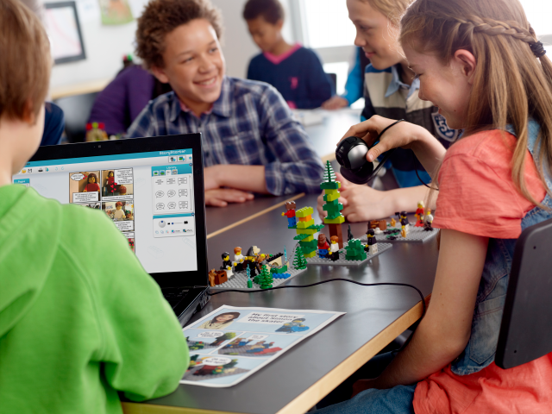
StoryVisualizer Software
Downloadable software compatible with PC and Mac, along with iOS app.
Few of many benefits using the StoryVisualizer software:
A great visual representation of knowledge
Easier to remember a visual graphic containing key information
Encourages students with low interest in writing
Develops creative and higher level thought processes
Enriches reading, writing and thinking skills
Serves as an assessment and evaluation tool
Enhances composition technique through visual-verbal connection
Helps organization through storytelling and storyboarding
Notes:
Gitte

Slide 9
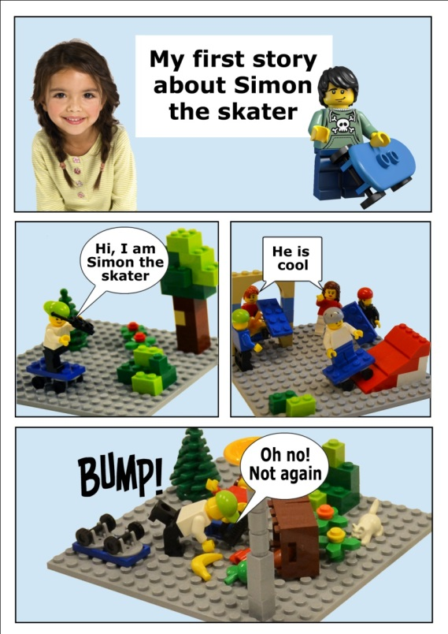
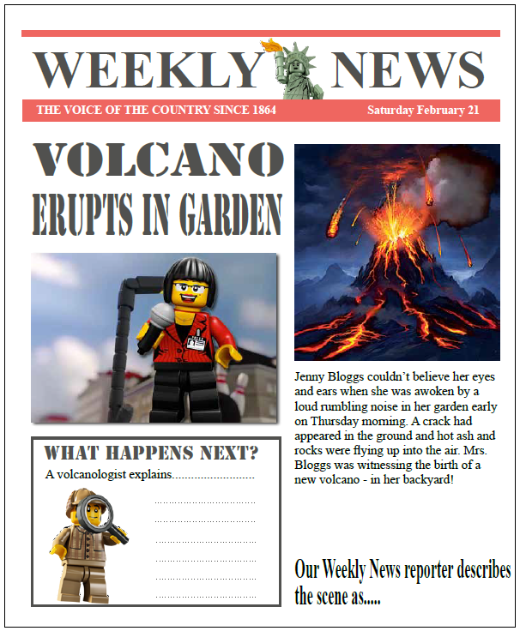
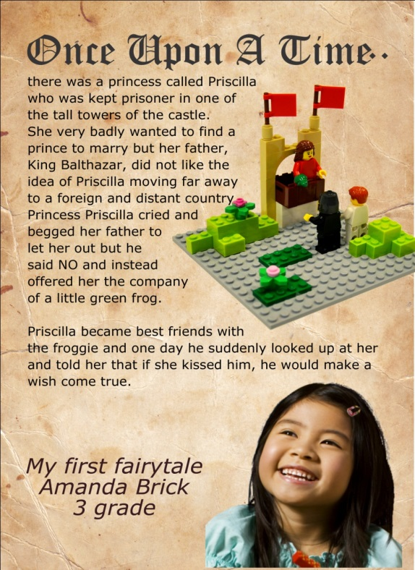
Examples from the Software
Comics
News
Fairy Tales
Notes:
Gitte

Slide 10
Teacher Reactions
The biggest impact that StoryStarter has made on my classroom is that the students are now eagerly looking forward to writing. In fact, according to my students, writing has increased in rank from 4th place to 1st place on the students list of students’ favorite subjects in school.”
Eric Slay 2nd Grade Teacher Betsy Ross Elementary Anaheim, CA
I agree that my kids are VERY motivated on LEGO StoryStarter days. I feel that the speaking standards are being met over and over. WONDERFUL for my ELLS. I also feel that by using a text map, they have really gained an understanding of what makes a narrative.”
Jennifer Jaworski Reading Interventionist Shenk Elememntary School Madison WI
Since my students thought of it as fun, many of them didn’t realize they were learning throughout the process. For students who do not usually think of themselves as good writers, StoryStarter acted as a springboard into a part of themselves they didn’t know was there.”
Mary Walser 3rd Grade Teacher Fairview Elementary School High Point, NC
Student engagement was higher and they were all able to equally participate in the activity. The biggest impact is that the students were eager to write their stories and they were very proud of what they created.”
Ofelia Medina 2nd Grade Teacher TIPS South Hill Academy West Covina, CA
Notes:
Pam

Slide 11
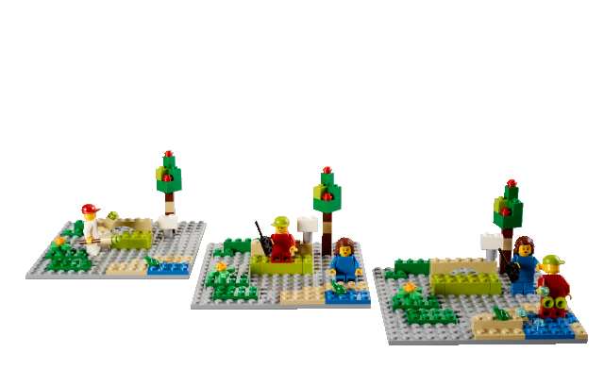
Student Reactions
Notes:
Lisbeth

Slide 12
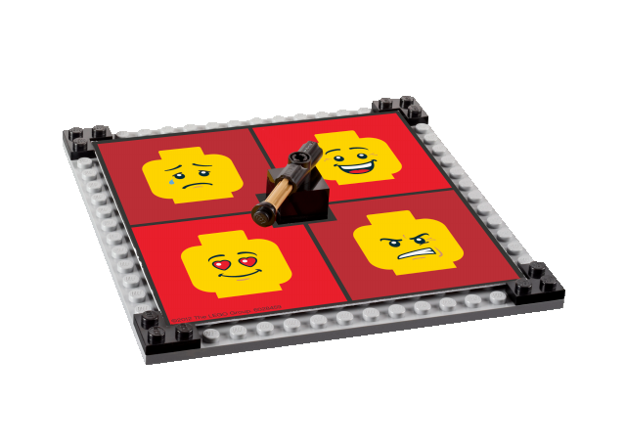
Let’s Get Going
Building & Telling Stories
Setting the scene: It’s a beautiful warm morning in the park. Polly the painter is out early “I must finish painting this park bench before the visitors arrive,” she thinks. Buy Polly desperately has to use the bathroom. “I must remember to put up the ‘wet paint’ sign…….
2. Build your story create 3 scenes
Work in pairs using one workshop kit. .
Consider scenario, time & place, characters, props, and main events.
What depicts a park scene? How can it be created?
How can wet sticky paint be represented? How can its removal be portrayed?
What happens?
3. Reflecting
What is the setting? How can you depict Polly’s situation?
Are there other visitors in the park? What are they doing?
How will you depict the changing mood and atmosphere?
Examples: Relaxation, surprise, anger, or humor?
Notes:
Lisbeth
NOTES for the activity:
Introducing the task – use the storyteller hat. This hat makes even the poorest storyteller come up with so many good ideas – you will be overwhelmed by inspiration, creativity… if you put on the thinking storyteller hat. Up for sharing☺
The objective of the activity:
Tell a story using relevant descriptive details to support main ides
Identify and describe characters, settings and major events in a story using key details
Get to know how to use the set most effectively and start the process of becoming verbally proficient
Information:
They will be working in their groups of five with one StoryStarter Set
They should think in all the story elements; Who and Where – character and setting
You could make a make-belief story, a fantasy, a fairy tale, what did you do yesterday thing etc.

Slide 13
Retelling Activity
Retell and Analyze the story “Spoon” by Amy Krouse Rosenthal and Scott Magoon
Setting the scene
Building the story
Reflecting
Sharing and documenting
Extending
Notes:
Who are our main characters?
What are the main events?
Is there a theme or moral to this story?

Slide 14
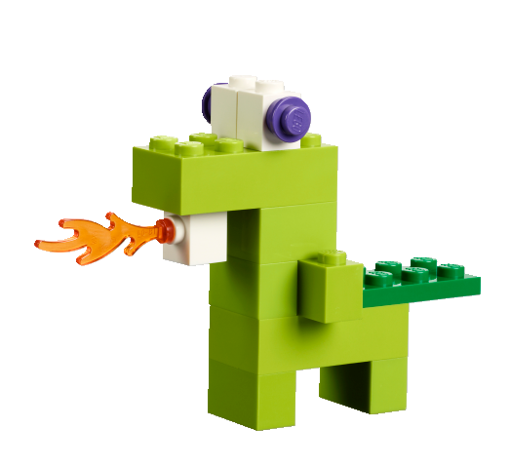
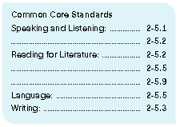
What did we learn?

Slide 15
Classroom examples
Notes:
Gitte

Slide 16
Classroom examples

Slide 17
Classroom Examples
Notes:
Lisbeth

Slide 18
Classroom Examples
Notes:
Lisbeth

Slide 19
Classroom Examples
Notes:
Lisbeth

Slide 20
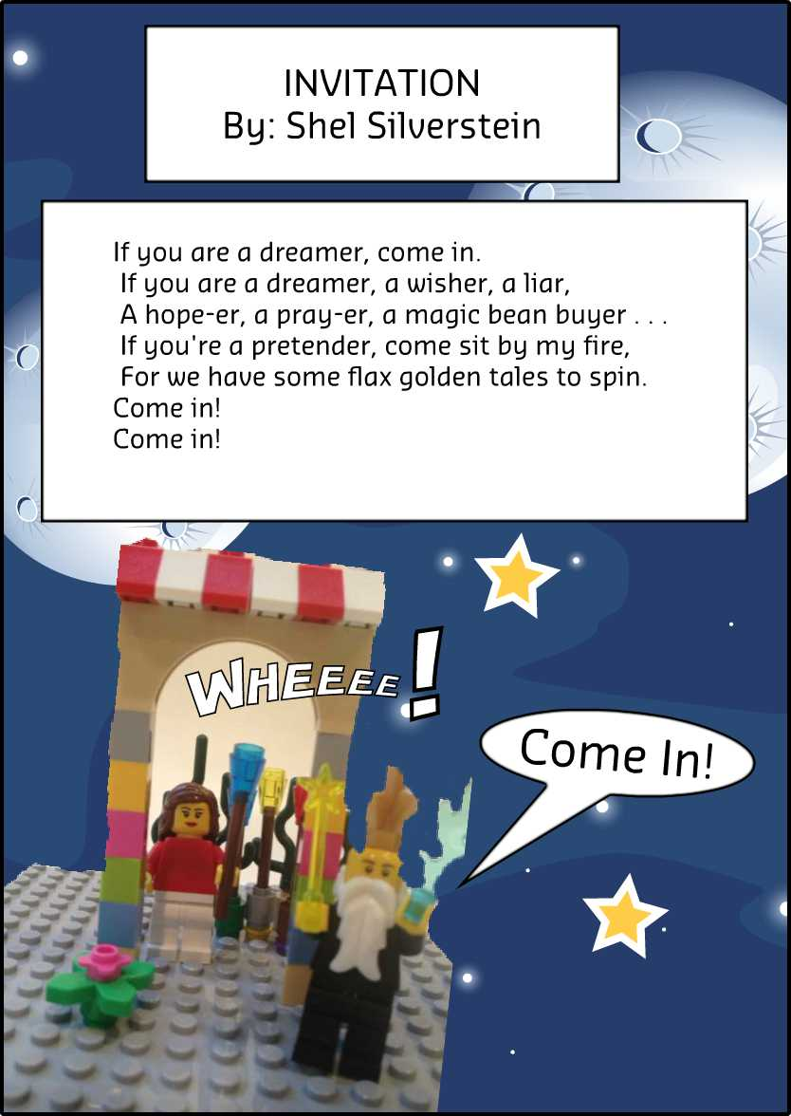
Classroom Examples
Poetry Analysis:
Components of a poem
Introduction to rhyming, alliteration, or figurative language

Slide 21
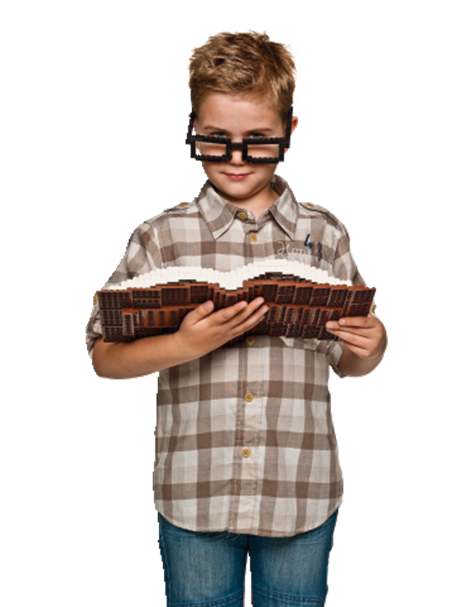
Questions?
Please visit www.LEGOeducation.us/StoryStarter to find:
Videos
Recorded Webinars
Case Studies and more!

