Slide 1
Livescribe Smart Pens
Jan LaFevers MSed
Reeds Spring Middle School
Reeds Spring, MO. 65737
jan.lafevers@gmail.com

Slide 2
Multiple Uses
Note taking
Direct Instruction
When you can’t be there
Differentiated Instruction
Formative Assessment
Notes:
My first introduction to what a Smartpen can do! Wow! A student can take notes and go back to review what was said in class? What a great idea!

Slide 3
Direct Instruction Flipped
Notes:
The whole idea of a flipped classroom seems daunting until you find the right tools. What can I do with this tool as a teacher that will help my students? What kind of files does it create and how can the pages and audio be shared?
Go online and explore

Slide 4
What the Echo looks like
Notes:
There is a difference with how the pencasts are formatted now.

Slide 5
When you can’t be there
Notes:
Substitutes will love having access to your files to share in the classroom. Students will feel that you are still there.

Slide 6
Differentiation
Notes:
Differentiation can happen with this tool too! 1.) For the student that is absent frequently 2.) the student that misses the details the first, second and third time. 3.) How about letting the student use the pen to record their verbal understanding?!

Slide 7
As a student tool
Notes:
Great for note taking and recording audio for translating later. It does the script to text too!

Slide 8
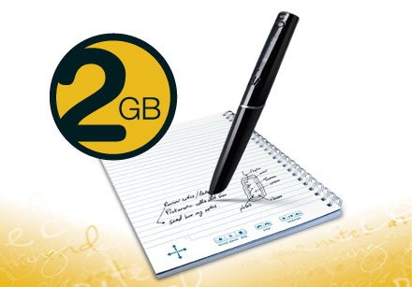
The Echo
Pencast library
Notes:
Other resources online

Slide 9
Smartpen 3 Pro
Notes:
Does everything the Echo does, but now it works better with the ipad and the pencasts are accessed differently. Not sure this is a good thing, but the usefulness is still valuable.

Slide 10
What will we think of next?

