Slide 1
Artist Otto Dix:
Documenting the Horrors of the Great War
(A High School Lesson)
Teaching American History Grant
Traveling America’s C’s: World War I
Southwest Center of Educational Excellence
Created by Glenn Oney

Slide 2
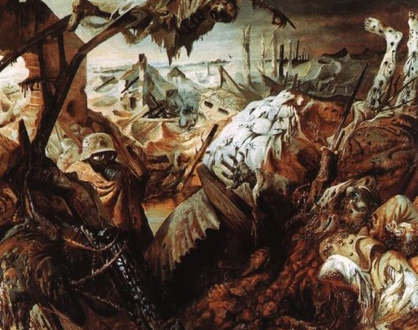
Artist Otto Dix:
Documenting the Horrors of the Great War
Otto Dix, The Trench, 1923.

Slide 3
Pre-Test
Artist Otto Dix:
Documenting the Horrors of the Great War
How did German artist Otto Dix come to find himself fighting in World War One?
A. He was already a member of the German Army when war broke out.
B. He volunteered to join the German Army when war broke out.
C. He was drafted by the German Army after the war broke out.
D. He decided to cross the border and join the Austrian-Hungarian Army rather than fight for Germany.
What major battle did Otto Dix participate in on the Western Front in 1916?
A. First Battle of Ypres
B. Battle of Loos
C. Battle of Verdun
D. Battle of the Somme
In 1924, Otto Dix released a series of etchings and prints based on his experiences and nightmares of WWI known as
A. The War (Der Krieg)
B. The Leader (Der Fuhrer)
C. My Struggle (Mein Kampf)
D. My Memories (Mein Speicher)
4. What was the reaction to Otto Dix’s 1923 painting The Trench which showed decomposing corpses in a trench?
A. He was arrested for indecency.
B. It was critically popular and he became a financial success.
C. Dix was fired from his teaching job at university.
D. The museum’s director was forced to resign.
5. What happened to Otto Dix when Hitler and the Nazis came to power in 1933?
A. Hitler was a fan of Dix’s work since both were veterans of the German Army from WWI.
B. Dix was given a job with the Nazi Propaganda division to create work for the Nazi Party.
C. Dix was labeled as a degenerate artist, fired from his job, and forced to paint landscapes.
D. Dix escaped Nazi Germany and fled to New York City.

Slide 4
Historical Background / Lesson Summary
Artist Otto Dix:
Documenting the Horrors of the Great War
The Great War, later to become known as World War One, tore Europe apart, altering the political, economic, military, and social landscape of a continent forever. Simultaneously, a whole generation of young men were to be scarred. The war began in the late summer of 1914, and by the time the guns went silent on November 11, 1918, nine and a half million men had been killed, while twice that number had been wounded, many disfigured for life. Nothing would ever be the same again.
Germany and her people were particularly devastated by World War One. Heavy losses amongst what was due to be their greatest generation, and the dire political and economic consequences set down by the Treaty of Versailles would lead to great hardship in the years following the conflict.
It is often said that history is “written by the victors”, and from a simplistic view that may be true. However, the history World War One from the German perspective can be found through the arts.
One of the great war novels (and soon after motion picture) All Quiet on the Western Front, penned by former German soldier Erich Maria Remarque, offers a fascinating look at the conflict from the perspective of the defeated.
An often overlooked area of study are a generation of German painters and artists that experienced the horrors of war both on the battlefield and the home front. Artists like Otto Dix, George Grosz, and Kathe Kollwitz are unknown to most students, but their body of work allows a glimpse into the tragedy of war both on the battlefield and the streets of Germany following their defeat as they attempted to rebuild their society within the confines of the conditions set down by the Treaty of Versailles.
This short lesson will introduce students to the German artist Otto Dix. His work provides valuable primary resources that will enable students to better understand the war and postwar Germany better from the perspective of the Germans themselves.

Slide 5
Anticipatory Set
Artist Otto Dix:
Documenting the Horrors of the Great War
Students will use the following links to biographies of German artist and WWI veteran Otto Dix, to complete a background worksheet.
Otto Dix (Wikipedia)
  http://en.wikipedia.org/wiki/Otto_Dix
The Online Otto Dix Project
  http://www.ottodix.org/index/biography
Otto Dix (Spartacus Educational)
  http://spartacus-educational.com/ARTdix.htm

Slide 6
Anticipatory Set
Artist Otto Dix:
Documenting the Horrors of the Great War
How did German artist Otto Dix come to find himself fighting in World War One?
A. He was already a member of the German Army when war broke out.
B. He volunteered to join the German Army when war broke out.
C. He was drafted by the German Army after the war broke out.
D. He decided to cross the border and join the Austrian-Hungarian Army rather than fight for Germany.
What major battle did Otto Dix participate in on the Western Front in 1916?
A. First Battle of Ypres
B. Battle of Loos
C. Battle of Verdun
D. Battle of the Somme
In 1924, Otto Dix released a series of etchings and prints based on his experiences and nightmares of WWI known as
A. The War (Der Krieg)
B. The Leader (Der Fuhrer)
C. My Struggle (Mein Kampf)
D. My Memories (Mein Speicher)
4. What was the reaction to Otto Dix’s 1923 painting The Trench which showed decomposing corpses in a trench?
A. He was arrested for indecency.
B. It was critically popular and he became a financial success.
C. Dix was fired from his teaching job at university.
D. The museum’s director was forced to resign.
5. What happened to Otto Dix when Hitler and the Nazis came to power in 1933?
A. Hitler was a fan of Dix’s work since both were veterans of the German Army from WWI.
B. Dix was given a job with the Nazi Propaganda division to create work for the Nazi Party.
C. Dix was labeled as a degenerate artist, fired from his job, and forced to paint landscapes.
D. Dix escaped Nazi Germany and fled to New York City.

Slide 7
Do Now Activity
Artist Otto Dix:
Documenting the Horrors of the Great War
Students will complete a primary source analysis of four self-portraits of German painter and World War One veteran Otto Dix. The paintings to be analyzed are “Otto Dix, Self-Portrait with Carnation, 1912”, “Otto Dix, Self-Portrait as a Soldier, 1914”, “Otto Dix, Self-Portrait Wearing a Gunner's Helmet, 1914”, and “Otto Dix, Self-Portrait as Mars, 1915”.
After studying each version of Otto Dix’s self-portrait paintings, students will write an essay analyzing the changes Dix sees in himself as he transitions from civilian painter in 1912 to inexperienced soldier in 1914, and finally as an experienced veteran in 1915. Analyzing these sources will generate interest in the topic, assess prior knowledge, and generate student questions that will be addressed later in the “Do Now Activity”.

Slide 8
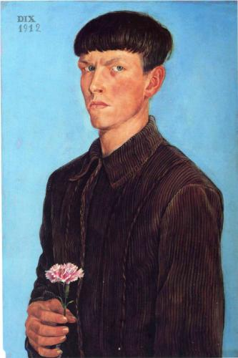
Otto Dix, Self-Portrait with Carnation, 1912, Oil on tempera on canvas, Institute of the Arts, Detroit.
In this painting we see an incredibly confident young man. Dix didn't just emulate an Old Master. He depicted himself as an Old Master. There are many established artists who would never consider doing such a thing, let alone doing it at aged 21.
http://www.ottodix.org/index/catalog-paintings

Slide 9
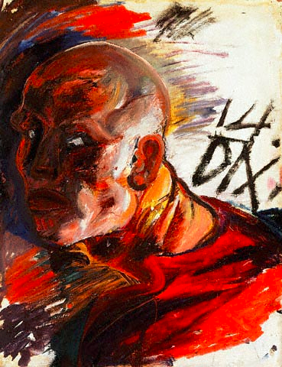
Otto Dix, Selbstbildnis als Soldat (Self-Portrait as a Soldier), 1914, ink and watercolour on paper, on both sides, 68 x 53.5 cm, Municipal Gallery, Stuttgart.
In the first year of war, Dix painted himself twice on one piece of paper. On this side, he is depicted in hellish combat with red and white flashes and eyes wide open.
http://www.ottodix.org/index/catalog-paintings

Slide 10
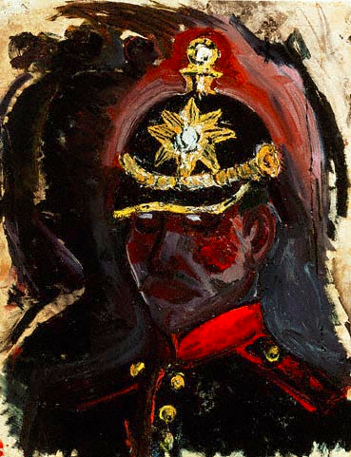
Otto Dix, Selbstbildnis mit Artillerie-Helm (Self-Portrait Wearing a Gunner's Helmet), 1914, ink and watercolour on paper, on both sides, 68 x 53.5 cm, Municipal Gallery, Stuttgart.
The other side of the piece above (on previous slide). A worried Dix is pictured in darkness in stark contrast with the gold insignia on his uniform.
http://www.ottodix.org/index/catalog-paintings

Slide 11
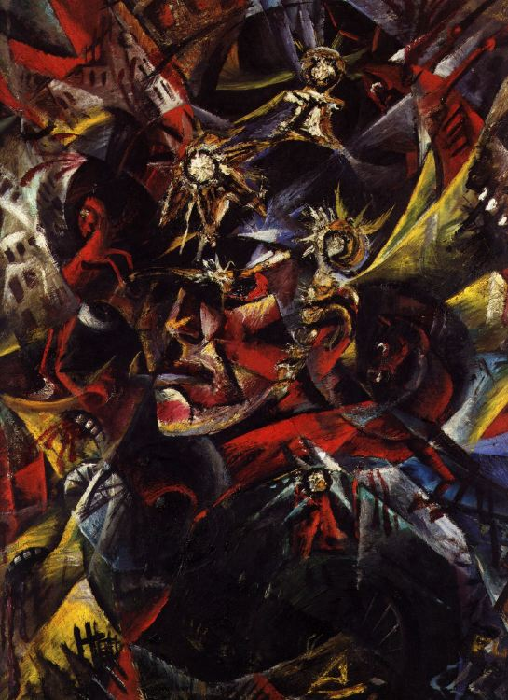
Otto Dix, Selbstbildnis mit Artillerie-Helm (Self-Portrait as Mars), 1915, Oil on canvas, Municipal Gallery, Stuttgart.
In the second year of war, he depicts himself as the God of War with angles borrowed from cubism. In this scene, death is abundant. Horses rear and flee. Buildings burst open and cities crumble. Yet Dix remains alive. Survival under such circumstances might give anyone a messiah complex.
http://www.ottodix.org/index/catalog-paintings

Slide 12
Do Now Activity
Artist Otto Dix:
Documenting the Horrors of the Great War
Essay
After studying and analyzing each version of Otto Dix’s self-portrait paintings, you will now write an essay analyzing the changes Dix sees in himself as he transitions from civilian painter in 1912 to inexperienced soldier in 1914, and finally as an experienced veteran in 1915.
Be sure to include evidence from our other studies (readings, notes, photographs, etc.) that reaffirm what you have seen in Otto Dix’s paintings.

Slide 13
Post-Test
Artist Otto Dix:
Documenting the Horrors of the Great War
How did German artist Otto Dix come to find himself fighting in World War One?
A. He was already a member of the German Army when war broke out.
B. He volunteered to join the German Army when war broke out.
C. He was drafted by the German Army after the war broke out.
D. He decided to cross the border and join the Austrian-Hungarian Army rather than fight for Germany.
What major battle did Otto Dix participate in on the Western Front in 1916?
A. First Battle of Ypres
B. Battle of Loos
C. Battle of Verdun
D. Battle of the Somme
In 1924, Otto Dix released a series of etchings and prints based on his experiences and nightmares of WWI known as
A. The War (Der Krieg)
B. The Leader (Der Fuhrer)
C. My Struggle (Mein Kampf)
D. My Memories (Mein Speicher)
4. What was the reaction to Otto Dix’s 1923 painting The Trench which showed decomposing corpses in a trench?
A. He was arrested for indecency.
B. It was critically popular and he became a financial success.
C. Dix was fired from his teaching job at university.
D. The museum’s director was forced to resign.
5. What happened to Otto Dix when Hitler and the Nazis came to power in 1933?
A. Hitler was a fan of Dix’s work since both were veterans of the German Army from WWI.
B. Dix was given a job with the Nazi Propaganda division to create work for the Nazi Party.
C. Dix was labeled as a degenerate artist, fired from his job, and forced to paint landscapes.
D. Dix escaped Nazi Germany and fled to New York City.

Slide 14
Grade Level Expectations
Artist Otto Dix:
Documenting the Horrors of the Great War
GLEs
3aX: Examine the wars of the twentieth-century pertinent to US History including: causes, comparisons, consequences, and peace efforts.
3aX: Describing the changing character of society and culture: (i.e., arts and literature, education and philosophy, religion and values, and science and technology).
6L: Changing of roles of various groups: Analyze how the roles of class, ethnic, racial, gender and age groups have changed in society, including causes and effects.
6M: Describe the major social institutions (family, education, religion, economy and government) and how they fulfill human needs.
7A: Distinguish between and analyze primary sources and secondary sources.
7F: Interpreting various social studies resources: Interpreting maps, statistics, charts, diagrams, graphs, timelines, pictures, political cartoons, audiovisual materials, written resources, art, and artifacts.

Slide 15
Resources
Artist Otto Dix:
Documenting the Horrors of the Great War
Visual Primary Sources (for Do Now Activity)
Otto Dix, Self-Portrait with Carnation, 1912, Oil on tempera on canvas, Institute of the Arts, Detroit.
http://www.wikipaintings.org/en/otto-dix/self-portrait-1912
Otto Dix, Selbstbildnis als Soldat (Self-Portrait as a Soldier), 1914, ink and watercolour on paper, on both sides, 68 x 53.5 cm, Municipal Gallery, Stuttgart.
http://www.memorial-caen.fr/10EVENT/EXPO1418/gb/texte/004text.html
Otto Dix, Selbstbildnis mit Artillerie-Helm (Self-Portrait Wearing a Gunner's Helmet), 1914, ink and watercolour on paper, on both sides, 68 x 53.5 cm, Municipal Gallery, Stuttgart.
http://www.memorial-caen.fr/10EVENT/EXPO1418/gb/texte/004text.html
Otto Dix, Selbstbildnis mit Artillerie-Helm (Self-Portrait as Mars), 1915, Oil on canvas, Municipal Gallery, Stuttgart.
http://www.ottodix.org/index/catalog-item/124.001.html

Slide 16
Resources
Artist Otto Dix:
Documenting the Horrors of the Great War
Written Primary Sources (for Anticipatory Set)
Otto Dix (Wikipedia)
  http://en.wikipedia.org/wiki/Otto_Dix
The Online Otto Dix Project
  http://www.ottodix.org/index/biography
Otto Dix (Spartacus Educational)
  http://spartacus-educational.com/ARTdix.htm

Slide 17
Resources
Artist Otto Dix:
Documenting the Horrors of the Great War
Google Docs
Teachers may click the links below to receive permission to have this lesson “shared” through Google Docs. Then, if students have access to computers and Google Docs, the lesson may be shared with them to be done online.
Presentation: https://docs.google.com/a/neoshor5.org/presentation/d/17sYf_swyUdmyjLd52OWiDykz16uw1pBMCfWYj5t7Amc/edit#slide=id.p13
Pre/Post Test: https://docs.google.com/a/neoshor5.org/document/d/19MV2Dztqn8tQChooXR6GR4aKFzsrsrVRMDVYyvfMIms/edit

