Slide 1
STUDENT GROWTH MEASURES
Office of Educator Quality
2013-2014
Notes:
JIM: pgs 1 – 55
MELISSA: pgs 56-95ish
JAN: 102- End

Slide 2
Norms
Workbook Pg. 1
Workbook Pg. 1
Be Present and Professionally Courteous
Be Open Minded
Be Willing to Engage in Conversation, Share Ideas, and Ask Questions
Look through the Lens of “How Might I Transfer…”
Southwest Center
www.southwestcenter.org
Southwest Center
www.southwestcenter.org
Notes:
-Review established norms.
-Norms are consistent throughout all four modules. -Trainers may use chart paper or table tents to display/model norms.

Slide 3
Why is Educator Evaluation Important?
The single most important influence on student learning is the quality of the teacher.
Charlotte Danielson
Notes:
-Importance of teacher evaluation…supporting quote…

Slide 4
Why is Educator Evaluation Important?
The greatest challenge that most students experience is the level of competence of the teacher.
John Hattie
Notes:
-Importance of teacher evaluation…supporting quote…

Slide 5
Why is Educator Evaluation Important?
The effect of “increases in teacher quality” swamps the impact of any other educational investment, such as reductions in class size.
Goldhaber, 2009
Notes:
-Importance of teacher evaluation…supporting quote…

Slide 6
Why is Educator Evaluation Important?
Having a high-quality teacher throughout elementary school can substantially offset or even eliminate the disadvantage of low socio-economic background.
Rivkin, Hanushek and Kain, 2002
Notes:
-Importance of teacher evaluation…supporting quote…

Slide 7
Refresher
Notes:
-Preface the audience on the material found within “Refresher”… -Honor the fact that much of what they are about to hear in the next 8-10 minutes will be review. However, it has been determined that this is important foundational information for all participants, at the beginning of each module.

Slide 8
Educator Evaluation
Senate Bill 291 (2010)
Development of New Teacher Standards (2011)
NCLB Flexibility Waiver (2012)
Essential Principles of Effective Evaluation (2012)
Missouri Educator Evaluation Model—Pilot (2012-2013)
Educator Evaluation Overview and Training (2012-2014)
Notes:
-Briefly refresh participants on how Missouri’s Educator Evaluation System has developed/evolved…
-Each stage will be defined in more detail in upcoming slides.

Slide 9
Senate Bill 291
June, 2010
Directing school districts to adopt teaching standards which were to include the following elements:
--students actively engaged in learning process
--various forms of assessment
--teacher is prepared and knowledgeable of content
--uses professional communication and interaction in school community
--keeps current on instructional knowledge
--responsible professional in overall mission of school
Notes:
-Review intent of Senate Bill 291.

Slide 10
Involvement of Stakeholders
More than 3 years of work.
Partners involved with the creation/development:
27 organization partners including
American Federation of Teachers of Missouri (AFT)
Missouri Association of Elementary School Principals (MAESP)
Missouri Association of Rural Education(MARE)
Missouri Association of School Administrators (MASA)
Missouri Association of Secondary School Principals (MASSP)
Missouri National Education Association (MNEA)
Missouri School Boards’ Association (MSBA)
Missouri State Teachers Association (MSTA)
32 school district partners
25 higher education partners
Notes:
-Remind participants of the level of involvement of all stakeholders and how this is vastly different to the approaches used in the past.

Slide 11
Teacher Standards (2011)*
Standard #1 (5 Quality Indicators)
Content Knowledge Aligned with Appropriate Instruction
Standard #2 (6 Quality Indicators)
Student Learning, Growth and Development
Standard #3 (3 Quality Indicators)
Curriculum Implementation
Standard #4 (3 Quality Indicators)
Critical Thinking
Notes:
-9 Standards listed with 4 of the 9 on this slide. -Call attention to the wording of each standard and note the number of Quality Indicators found within each standard.
Handout: Standards and Indicators

Slide 12
Teacher Standards
Standard #5 (3 Quality Indicators)
Positive Classroom Environment
Standard #6 (4 Quality Indicators)
Effective Communication
Standard #7 (6 Quality Indicators)
Student Assessment and Data Analysis
Standard #8 (3 Quality Indicators)
Professionalism
Standard #9 (3 Quality Indicators)
Professional Collaboration
Notes:
-9 Standards listed with 5-9 on this slide. -Call attention to the wording of each standard and note the number of Quality Indicators found within each standard.

Slide 13
36 Quality Indicators
Notes:
-Quality Indicator comparison visual -Call attention to Learning Growth and Development and Use of Student Data containing most Quality Indicators.
-Take a moment to reflect on the indicators within these two areas.

Slide 14
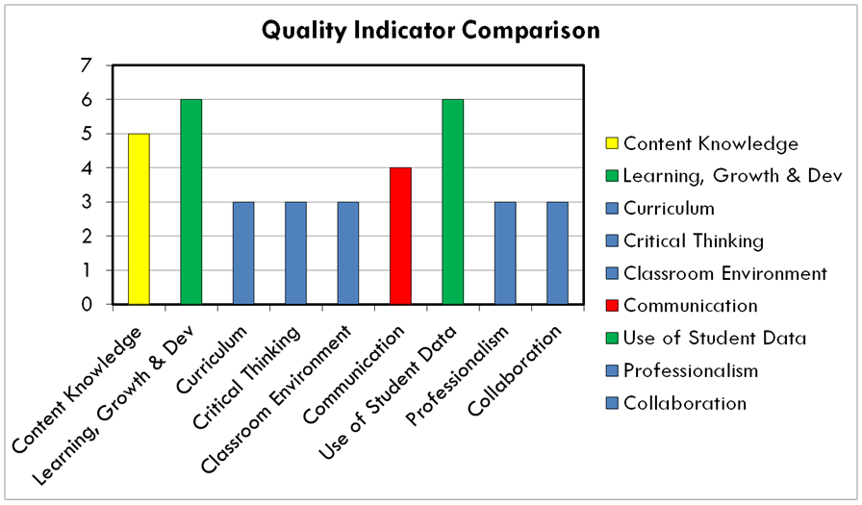
What does this mean for…
If the following standards are most prevalent:
-what does this mean for the teacher?
-what does this mean for the instructional leader?
-what does this mean for school-wide professional development?
Notes:
-Prompt participants to turn to shoulder partner and respond to the following:
*Because these teacher standards are research-based, what does this mean for the teacher? evaluator? the professional development needs?
-Prompt participants to scan handout of teacher standards to assist with discussion.

Slide 15
#2 State Developed Differentiated Recognition, Accountability and Support
#3 Supporting Effective Instruction and Leadership
Missouri Learning Standards and State Assessment Alignment
English Language Arts
MSIP 5 Missouri School Improvement Program
Missouri's Educator Evaluation System
New Teacher and Leader Standards
#1 Develop College and Career Ready Expectations for All Students
Performance Standards
Essential Principles of Effective Evaluation
Mathematics
Resource and Process Standards
Missouri Model Evaluation System
ESEA Flexibility Waiver June, 2012
Notes:
-The purpose of this visual is to outline for participants the three primary objectives within the waiver…and how “educator evaluation” plays a key part.

Slide 16
Missouri’s NCLB Waiver says…
“The essential principles of effective evaluation are the foundation for the state’s model. Local evaluation models align to these principles to create consistency in assessing educator performance across the state.”
Notes:
-Review with participants.

Slide 17
7 Essential Principles Per NCLB Waiver (June, 2012)
Measures educator performance against research-based proven practices
Differentiated levels of performance
Probationary period
Measures of growth in student learning
Meaningful and descriptive feedback
Training for evaluators
Results and data informs decisions regarding personnel, employment, and policy
Notes:
7 Essential Principles:
-Explain how the 7 Essential Principles are found within NCLB Waiver.
-All districts will need to ensure their adopted educator evaluation model aligns to each of the 7 Essential Principles by 2014-2015. -You may recall using these 7 Essential Principles during a local evaluation review process at the end of the overview sessions offered during the 2012-2013 school year.
-Missouri model is aligned to each of the 7 Essential Principles.

Slide 18
MO Educator Evaluation System Pilot Project
Regional Overviews Conducted (Fall 2012)
2012-2013 School Year
Focused on the improvement of effective educational practices and the professional development of teachers
Notes:
-Overview of Educator Evaluation System “Pilot Project”

Slide 19
Missouri’s Educator Evaluation System (Webpage)
http://dese.mo.gov/eq/ees.htm
Notes:
-Take the opportunity for participants to visually see the format/layout of Educator Evaluation System webpage.
-Goal of this slide:
*visually see how to access EES information as leader
*communicate the fact that this web resource will continue to evolve with additional resources, even changes

Slide 20
2013-2014 Training Roadmap*
Educator Evaluation Training
Foundation
Probationary
Evaluator Training and Feedback
Student Growth Measures
Notes:
-This visual informs participants of the 4 training modules. Handout: 4 Modules (outline of intended outcomes)

Slide 21
To Clarify…
All training shared today is model neutral, as each school district has local control over what model is developed or adopted.
The intent of each Educator Evaluation System training module is to support schools in their efforts to align their chosen model to the 7 Essential Principles (as outlined in the ESEA Waiver of June 2012).
What are school districts accountable for?
Notes:
-The purpose of this slide is to clear any misconceptions about “what” the training intentions are. -The training is “model neutral”…as districts are required to ensure that whatever model selected or designed is aligned to the 7 Essential Principles of Effective Evaluation.

Slide 22
7 Essential Principles Per NCLB Waiver (June, 2012)
Measures educator performance against research-based proven practices
Differentiated levels of performance
Probationary period
Measures of growth in student learning
Meaningful and descriptive feedback
Training for evaluators
Results and data informs decisions regarding personnel, employment, and policy
Notes:
-Remind participants that training has been developed to specifically support schools in their alignment efforts to the 7 Essential Principles. -Missouri Model will be referred to in order to provide examples of principles.

Slide 23
Today’s Roadmap
Notes:
-Trainer is about to introduce the key topics (or chunks) of today’s content:
Principle #4 Intended Outcomes
Terminology

Slide 24
2013-2014 Training Roadmap*
Educator Evaluation Training
Foundation
Probationary
Evaluator Training and Feedback
Student Growth Measures
Notes:
-This visual informs participants of the 4 training modules and identifies the focus of this module. Handout: 4 Modules (outline of intended outcomes)

Slide 25
Essential Principles Per NCLB Waiver (June, 2012)
Measures educator performance against research-based proven practices
Differentiated levels of performance
Probationary period
Measures of growth in student learning
Meaningful feedback
Training for evaluators
Results and data informs decisions regarding personnel, employment, and policy
Notes:
-Remind participants that “measures of growth in student learning” is one of the 7 Essential Principles of Effective Evaluation.

Slide 26
Principle #4 Critical Components
Student growth measures are a significant contributing factor in educator evaluation
Uses multiple measures including formative and summative assessments
Includes multiple years of comparable student data
Highlights student growth across two points in time
Includes the state assessment where available and appropriate and additional district and school determined assessments
Notes:
-Defining Principle 4

Slide 27
Intended Outcomes
Determine current reality and foundational elements necessary in the use of student growth as a component of a comprehensive educator evaluation system
Identify the key components that can be used as student growth measures within educator evaluation system.
Develop a sample Student Learning Objective (SLO) using the professional growth plan
Create a plan for educating/modeling to staff how to create a SLO
Notes:
-By the end of this training module, participants will:

Slide 28
Keep in Mind…
This training will not answer every question or address every issue, but it will provide LEAs with a starting point in terms of how to begin to incorporate “student growth measures” in the evaluation process.
Notes:
-Slide prefaces training content with the idea that the support for implementation of SGM is evolving and that participants may leave this training with questions unanswered.

Slide 29
Terminology*
Workbook Pg. 2-3
Student Learning Objective
Educator Growth Plan
Student Growth Measure
Formative Assessment
Summative Assessment
Student Growth Percentage Value-Added Model
Missouri Growth Model
Normal Curve Equivalent
Data-Based Decision Making
Score Pairs
Southwest Center
www.southwestcenter.org
Notes:
-Key terminology for Student Growth Measures training module. Handout:
Terminology

Slide 30
Student Growth Measures as part of an Educator Evaluation System
Workbook Pg. 4-5
Southwest Center
www.southwestcenter.org
Notes:
-Opening slide to content regarding those “foundational elements” that a school will need to consider prior to implementation of SGM as a part of education evaluation practices.

Slide 31
Why Student Growth Measures Reeves-Decision Making for Results
Confirm or discredit assumptions about students and school practices.
Get to the “root” cause(s) of problems.
Help schools evaluate program effectiveness.
Notes:
-Reasons why SGM can be assistive to schools and performance

Slide 32
Why Student Growth Measures Reeves-Decision Making for Results
Provide the feedback teachers and administrators need to keep going and stay on course.
Prevent “one size fits all” and “quick solutions”…
Help build a culture of inquiry and continuous improvement.
Notes:
-Reasons why SGM can be assistive to schools and performance continued

Slide 33
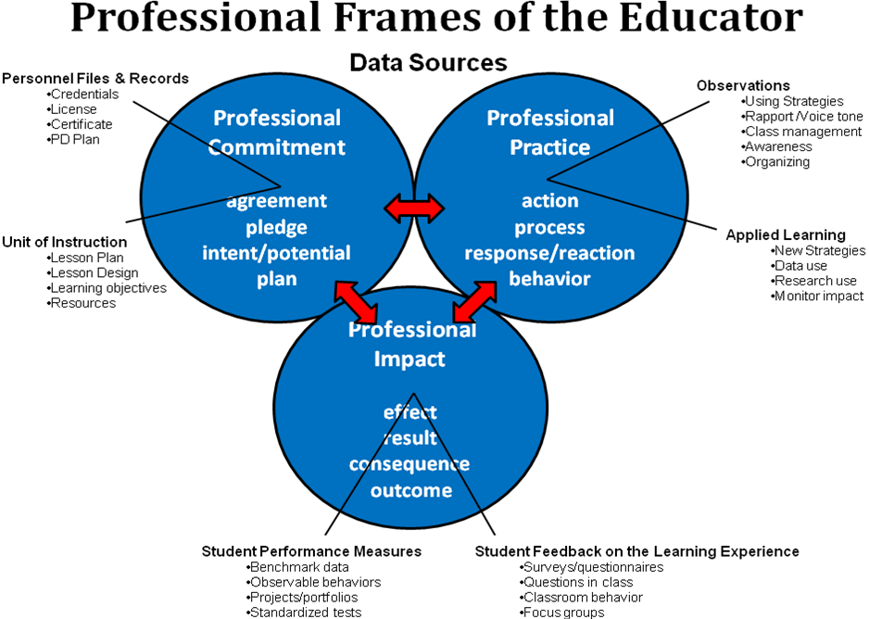
Notes:
-3 Professional Frames (Commitment, Practice, Impact)
-How will schools determine the “IMPACT” of teacher practice?

Slide 34
Current Reality: 3 Frames
Reflecting on your current educator evaluation system…which of the three frames is most used:
How do you measure and reflect on impact?
Notes:
-The intent of this slide is to prompt reflection among schools around the idea that traditional evaluation processes have been geared towards observation of practice versus “impact”…
-More specific prompts on upcoming slide.

Slide 35
Anthony’s Teacher
The following example illustrates the concept of student growth:
At the beginning of the year, Anthony has very limited knowledge about the Body Mass Index (BMI). He has a vague idea about what the term BMI stands for, the factors that affect it, how to change it or even why he would want to, as evidenced by achieving a 71% on his teacher’s initial assessment. Anthony’s score of 71% was slightly better than the 68% averaged by his classmates.
Notes:
-The purpose of the Anthony’s Teacher example is to frontload in participant’s minds about “what exactly” we are talking about when referring to Student Growth Measures: *across two points in time *measuring essential learning which is highly relevant for specific course

Slide 37
Anthony’s Teacher (Process)
Anthony’s teacher plans her instruction and learning activities to address the content areas needed by her students that she will deliver over the next three weeks.
She defines mastery of this content as being an average score for her students of 80% or better. Following this unit of instruction, Anthony takes his teacher’s assessment and scores a 91%, which is better than the 87% averaged by his classmates.
It is important to note that Anthony’s teacher could have used a wide variety of different assessments to determine mastery of her students (i.e. quiz, paper, chart, project, etc.).

Slide 38
Performance Goal: 80%
In this example…Anthony’s teacher “met” his/her established GOAL.

Slide 39
Principle #4 Critical Components
Student growth measures are a significant contributing factor in educator evaluation
Uses multiple measures including formative and summative assessments
Includes multiple years of comparable student data
Highlights student growth across two points in time
Includes the state assessment where available and appropriate and additional district and school determined assessments
Let’s take a look at each of these components…one at a time.
Notes:
-Prompt table teams to generate 5-10 questions they might have in regards to the five “critical components”
-Table teams will report out one burning question generated. Trainer will record these questions on a sheet of chart paper so that these questions can be referred to later in session (SLO).

Slide 40
1: Student growth measures are a significant contributing factor in educator evaluation
Survey Data
Observation
Student growth measures
Other
Notes:
-The purpose of this slide is to communicate the concept of “balanced model”…how student growth measures is to be one component of a set of components…

Slide 41
2: Uses multiple measures including formative and summative assessments
Formative
Common formative district-generated assessments
Peer reviewed performance assessments
Summative
Standardized state assessment results should not be the primary source of information used for measuring student growth.
Student learning objectives
Individualized student growth objectives
Student work samples
Results on pre-tests and post-tests
Notes:
-The purpose of this slide is to communicate the concept of “formative” and “summative” measures to be inclusive…

Slide 42
3: Includes multiple years of comparable student data
Notes:
-The purpose of this slide is to communicate the concept of “multiple years” of comparable data…looking for trend data.
-This is a “state assessment” visual…

Slide 43
4: Includes multiple years of comparable student data
Notes:
-The purpose of this slide is to communicate the concept of “multiple years” of comparable data…looking for trend data.
-This is a “local formative assessment” visual…

Slide 44
5: Highlights student growth across two points in time
Notes:
-The purpose of this slide is to communicate the concept of “two points in time”…to determine growth/progress.

Slide 45
6: Includes the state assessment where available and appropriate and additional district and school determined assessments
Notes:
-The purpose of this slide is to communicate the concept of “incorporating both” state and local assessment data…

Slide 46
Principle #4 Critical Components
Student growth measures are a significant contributing factor in educator evaluation
Uses multiple measures including formative and summative assessments
Includes multiple years of comparable student data
Highlights student growth across two points in time
Includes the state assessment where available and appropriate and additional district and school determined assessments
Is your foundation ready for this process?
Notes:
-Slide to prompt participants to think about “foundation for student growth measures as part of evaluation system”…is their foundation ready?

Slide 47
Current Practice?
How is student learning currently monitored, or reflected upon in your school?
Notes:
-Provide 4-5 minutes for table conversation/responses to prompt provided.

Slide 48
Do you have a history with these practices…?
Formative Assessment: Teachers are using ongoing or benchmark assessment information to monitor student learning outcomes.
SMART Goals: Specific…Measureable…Attainable…Results-Oriented…Time-bound
Teachers use baseline assessment information to establish goals focused on student learning outcomes. These goals usually outline what specific instructional practices teachers will work towards in order to reach these goals.
Notes:
-Prompting participants to see the connection to what they have already been doing…how might you build upon this?

Slide 49
Survey Data
Observation
Student growth measures
Other
Notes:
-Connecting back to “balanced” concept…
-It is about taking the time to look at this form of evidence to inform what is happening in teacher practice…

Slide 50
Missouri Model as Example…
Let’s take a moment to connect this concept of Student Growth Measures as “one” component of an educator evaluation system.
What does this look like in terms of a process?
Notes:
-Getting ready to reconnect to Missouri Model…

Slide 51
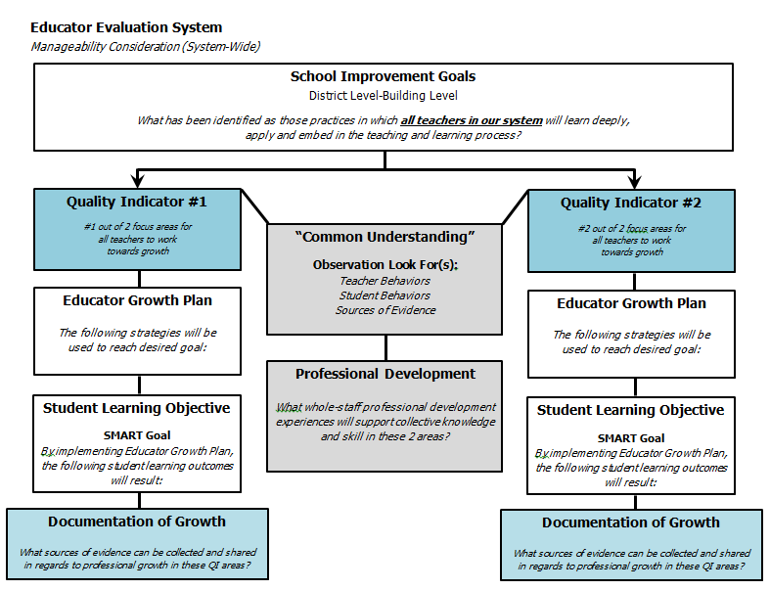
Notes:
-Take the time to refresh in participant’s minds the process shared during the Foundation module.

Slide 52
Notes:
-Take the time to refresh in participant’s minds the process shared during the Foundation module.

Slide 53
Educator Growth Plan* (Missouri Model)
FOCUS Based on evidence generated from the growth guide, determine strengths and a key opportunity for growth. This opportunity for growth then becomes the priority – the FOCUS – for your growth plan. | 2. GOAL Create a goal statement addressing the FOCUS. This goal statement should include these essential qualities: specific, measureable, achievable, relevant, and timely. What will be the result indicators?
3. STRATEGY Describe the specific strategy(ies) to be implemented that will address the goal statement. This strategy should provide the best plan for effectively addressing the FOCUS and include clear action steps and timeline. | 4. RESULTS What was the outcome of the strategy? Based on progress monitoring, provide the data that supports that the outcome of the strategy has effectively addressed the FOCUS.
Notes:
-Prompt them to think about the conversations in step 4 of the Educator Growth Plan…involving the use of student learning as part of reflection/results.

Slide 54
Notes:
-In addition to the Educator Growth Plan, teachers would complete a Student Learning Objective where they outline what specific learning standards will be measured, how they will be measured, and the teacher’s plan to allow for anticipated growth in student learning.

Slide 55
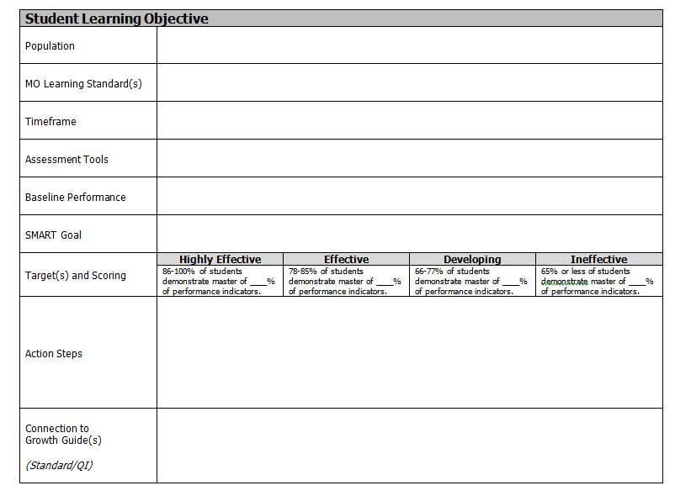
Workbook Pg. 6
Southwest Center
www.southwestcenter.org
Notes:
-Only touch upon this being a process that Missouri schools can use to capture student learning goals.

Slide 56
Planning for Change
As with any change process…we, as leaders, must do some thinking and planning prior to implementation in order for the change to be successful and embedded in the school culture.
We have to ask ourselves…do we have the necessary foundation for the use of student growth measures to be effective?
Notes:
-Transition into “Foundational Elements”

Slide 57
Foundational Elements Student Growth Measures
Notes:
-Opening slide to content regarding those “foundational elements” that a school will need to consider prior to implementation of SGM as a part of education evaluation practices.

Slide 58
Why Think About Foundation?
Too often, as schools, we adopt new processes or initiatives without thinking about the entire system. We are then left with little evidence to show that all the time, resources and effort put into the process was worthwhile.
So…how does the use of student growth measures fit into the school system?

Slide 59
Alignment
Curriculum
Common Core State Standards (Missouri Learning Standards)
Instruction
Research-Based Instructional Practices (Examples: Hattie and Marzano’s findings)
Assessment
Formative and summative measures
Reflection
Reflection on what instructional practice impacts student learning at high levels…
Notes:
-Visual showing how curriculum-instruction-assessment needs to be aligned.
-Reflection comes after reviewing assessment results…using those results to reflect on instructional practice.

Slide 60
Alignment
Curriculum
Common Core State Standards (Missouri Learning Standards)
“High Leverage” Standards
Notes:
-Curriculum

Slide 61
Curriculum The Safety Net
The Safety Net is a very limited set of learning objectives organized for each grade and for each subject. It is not the total curriculum – just the “safety net” that every teacher should ensure that every student knows.
“The “Safety Net” Curriculum” by Douglas B. Reeves, Ph.D., in Power Standards: Identifying the Standards that Matter the Most, Larry Ainsworth, Advanced Learning Press, 2003.
Notes:
-If we are getting ready to implement SGM as “one component” of an educator evaluation system…is it important for teachers to focus their measuring/monitoring on those learning targets that have: endurance essential for progress to next level contributes to understanding of other standards

Slide 62
Curriculum Safety Net Curriculum
What endures?
What skills and knowledge will students gain that last from one academic year to the next?
For example: The skill of constructing an informative essay is something that students need throughout their academic career. It is a skill that endures over time.
The same cannot be said, for example, of the requirement that a student memorize the formula for the area of a trapezoid.
Notes:
-If we are getting ready to implement SGM as “one component” of an educator evaluation system…is it important for teachers to focus their measuring/monitoring on those learning targets that have: endurance essential for progress to next level contributes to understanding of other standards

Slide 63
Curriculum Safety Net Curriculum
Essential for progress to the next level of instruction?
In a continuing dialogue with teachers at all grade levels, we must determine what is essential for future success.
For example: When 11th grade history teachers are asked what is essential for success in their classes, they rarely respond with items of historical knowledge that should have been memorized in middle school.
Rather, they typically respond that students should have skills in reading and writing, knowledge of map reading, and an understanding of the difference between democracy and authoritarianism.
Notes:
-If we are getting ready to implement SGM as “one component” of an educator evaluation system…is it important for teachers to focus their measuring/monitoring on those learning targets that have: endurance essential for progress to next level contributes to understanding of other standards

Slide 64
Curriculum Safety Net Curriculum
Contributes to understanding of other standards?
The safety net should comprise of standards that, once mastered, give a student the ability to use reasoning and thinking skills to learn and understand other curriculum objectives outside of the safety net.
For example: In a middle school mathematics class, the properties of a triangle and rectangle might be in the safety net, because this understanding will allow students to comprehend information about other shapes – rhombus, trapezoid, parallelogram – that are outside of the safety net.
Notes:
-If we are getting ready to implement SGM as “one component” of an educator evaluation system…is it important for teachers to focus their measuring/monitoring on those learning targets that have: endurance essential for progress to next level contributes to understanding of other standards

Slide 65
Alignment
Curriculum
Common Core State Standards (Missouri Learning Standards)
Instruction
Research-Based Instructional Practices (Examples: Hattie and Marzano’s findings)
Notes:
-Instruction

Slide 66
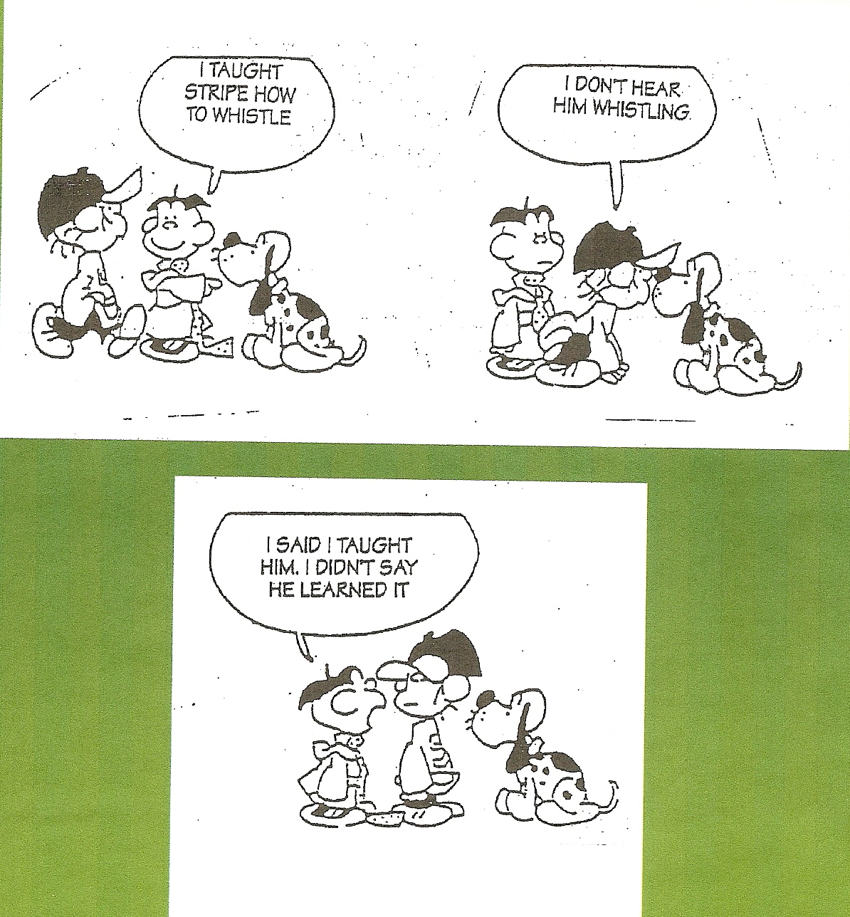

Slide 67
Research-Based Instruction
15+ years of research 800+ meta-analyses
50,000+ studies
240+ million students
Notes:
-One resource to determine what is effective -Exposure/reinforcement of Hattie’s resource -Mo Teacher Standard alignment to Hattie’s findings

Slide 68
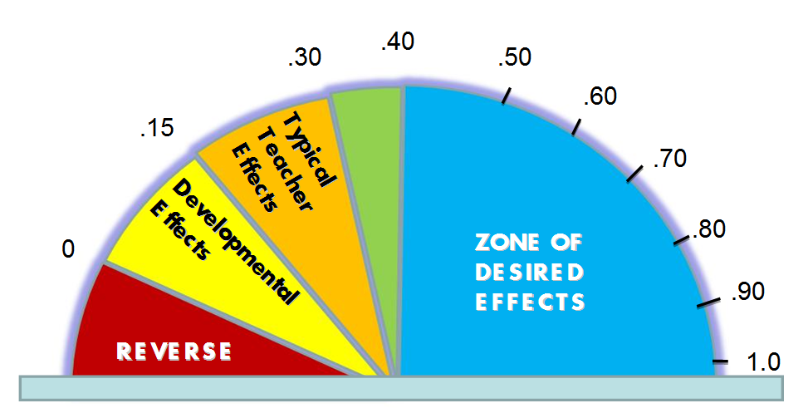
Research-Based Instruction
Notes:
-Effect size -.40=one year of academic growth -almost any effort will have some sort of effect, is it wise to choose and implement effectively those practices with high levels of return?

Slide 69
Rank the influences: 1 being the most effective in increasing student achievement to 12 being the least effective
Rank | Innovation
 | Feedback
 | Study Skills
 | Reading Recovery
 | Student Expectations
 | Cooperative Learning
 | Homework
 | Individualized Instruction
 | Ability Grouping
 | Open vs. Traditional Spaces
 | Mobility
 | Retention
 | Classroom Discussion
Workbook Pg. 7
* Hatti
Southwest Center - Webb City, MO www.southwestcenter.org
HO
Notes:
Identify strategies that have the greatest impact on student achievement.

Slide 70
Ranking of influences: 1 being the most effective in increasing student achievement to 12 being the least effective
Rank | Innovation
 | Feedback
 | Study Skills
 | Reading Recovery
 | Student Expectations
 | Cooperative Learning
 | Homework
 | Individualized Instruction
 | Ability Grouping
 | Open vs. Traditional Spaces
 | Mobility
 | Retention
 | Classroom Discussion
3
4
5
1
6
7
* Hatti
8
9
10
12
11
2
Southwest Center - Webb City, MO www.southwestcenter.org

Slide 71
Effect Size
Ability grouping
Acceleration
Feedback
Student-teacher relationships
Teaching study skills Cooperative learning
Homework
Individualized instruction
Hattie (2009, 2012)
Notes:
-We want teachers to be able to distinguish between high and lower effect size practices.
-High effect size practices will assist teachers in their professional growth. -Professional growth strategies should align to high effect practices.

Slide 72
Effect Size
Ability grouping (.12)
Acceleration (.88)
Feedback (.73)
Student-teacher relationships (.72)
Teaching study skills (.59)
Cooperative learning (.41)
Homework (.29)
Individualized instruction (.22)
Hattie (2009, 2012)
Notes:
-Effect size for each practice…

Slide 73
Research-Based Instruction
Marzano articulates his framework in the form of 10 questions that represent a logical planning sequence for successful instructional design…
Notes:
-One resource to determine what is effective -Exposure/reinforcement of Marzano’s resource -Mo Teacher Standard alignment to Marzano’s findings

Slide 74
Research-Based Instruction
What will I do to establish and communicate learning goals, track student progress, and celebrate success?
What will I do to help students effectively interact with new knowledge?
What will I do to help students practice and deepen their understanding of new knowledge?
What will I do to help students generate and test hypotheses about new knowledge?
What will I do to engage students?
Notes:
-One resource to determine what is effective -Exposure/reinforcement of Marzano’s resource -Mo Teacher Standard alignment to Marzano’s findings

Slide 75
Research-Based Instruction
What will I do to establish or maintain classroom rules and procedures?
What will I do to recognize and acknowledge adherence and lack of adherence to classroom rules and procedures?
What will I do to establish and maintain effective relationships with students?
What will I do to communicate high expectations for all students?
What will I do to develop effective lesson organized into a cohesive unit?
Notes:
-One resource to determine what is effective -Exposure/reinforcement of Marzano’s resource -Mo Teacher Standard alignment to Marzano’s findings

Slide 76
Alignment
Curriculum
Common Core State Standards (Missouri Learning Standards)
Instruction
Research-Based Instructional Practices (Examples: Hattie and Marzano’s findings)
Assessment
Formative and summative measures
Notes:
-Assessment

Slide 77
Assessment Use—Three Levels
School
Classroom
Students
Notes:
-Visual to show the 3 tiers of data use.
-We are getting better at using school-wide data to inform practice…how might we strengthen the use of “classroom data”…to inform the use of instructional practices

Slide 78
Assessment
Unit 1
Unit 2
Unit 3
Unit 4
I taught it, did they learn it?
Notes:
-Visual depicts how teachers have traditionally approached assessment…

Slide 79
Formative Assessment
Benchmark 1
1st Quarter
Benchmark 2
2nd Quarter
Benchmark 3
3rd Quarter
Benchmark 4
4th Quarter
Safety Net
Notes:
-We are working towards this mental model… -This model offers one approach of how to set up a process for SGM.

Slide 80
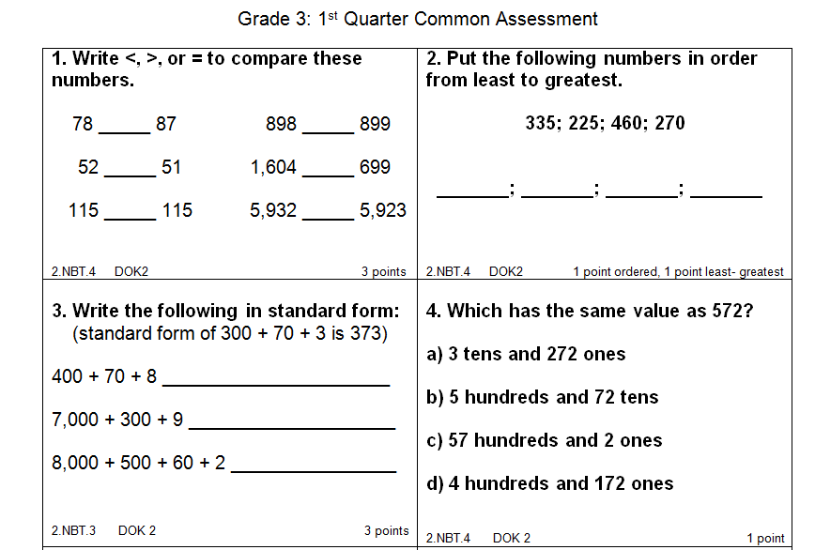
Notes:
-Example of how one school formatted an assessment in order to organize results…for easy interpretation and action planning.

Slide 81
Notes:
-Visual showing how skills can be focused and monitored through the use of formative assessment assessing skills throughout the school year.

Slide 82
Alignment
Curriculum
Common Core State Standards (Missouri Learning Standards)
Instruction
Research-Based Instructional Practices (Examples: Hattie and Marzano’s findings)
Assessment
Formative and summative measures
Reflection
Reflection on what instructional practice impacts student learning at high levels…
Notes:
-Reflection

Slide 83
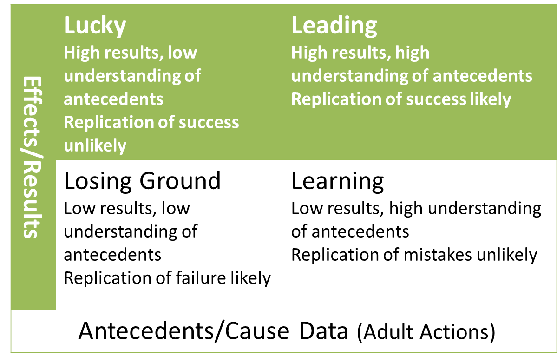
Reflective Practice (Reeves)
Notes:
-Explain quadrants.
-This model can be reflected on by a “school” or, as “teacher”…
-We are working to create systems where teachers are operating from the “learning” and “leading” quadrant frame of mind…

Slide 84
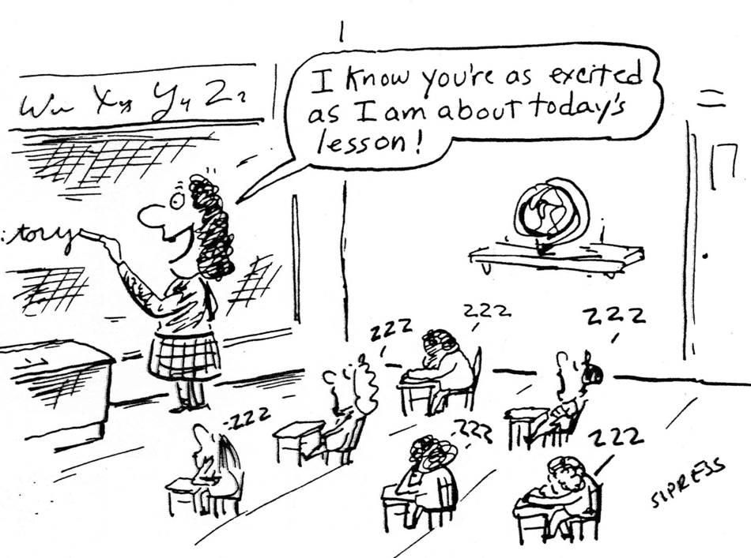
Notes:
-”Reflective practices” would provide opportunities for teachers and evaluators to identify possible “causes” to a specific problem: not excited about learning/today’s lesson…

Slide 85
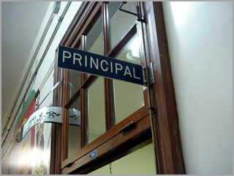
Reflective Practice
Outcome
Cause Examples
Significant # of behavioral referrals for the past 3 years…
What may or may not be happening in classrooms that might contribute to this effect?
Notes:
-Stand Up, Hand Up, Pair Up -Partner A, Partner B -Partner A processes this slide…thinking of example causes -Partner B adds other ideas not thought of…
-Potential “cause” examples: Inconsistent practices with classroom management Referrals may be coming from specific locations and times during day Poor student-teacher relationships Lack of engagement in teaching and learning practices

Slide 86
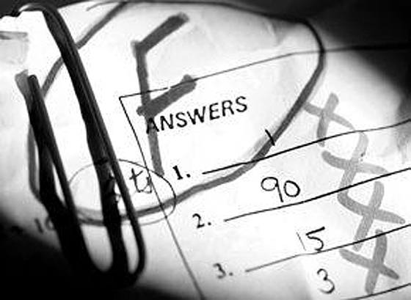
Reflective Practice
Outcome
Cause Examples
Low levels of proficiency in student performance…
What may or may not be happening in classrooms that might contribute to this effect?
Notes:
-Stand Up, Hand Up, Pair Up -Partner A, Partner B -Partner A processes this slide…thinking of example causes -Partner B adds other ideas not thought of…
-Potential “cause” examples:
Student engagement in instruction Use of or implementation of formative assessment Literacy Vocabulary Relevance

Slide 87
In Your School Setting…
To what degree is “reflective practice” happening in your classrooms currently?
What “challenges do you anticipate” when using student growth measures as part of the educator evaluation conversation in the future?
Notes:
-School teams reflect using the +/- prompts.

Slide 88
Reflective Practice and SGM
Outcome
Cause Examples
Trend data showing decreasing levels of student proficiency in mathematics
What may or may not be happening in classrooms that might contribute to this effect?
Notes:
-Reminding participants that a culture characterized by “reflective practice” will consist of teachers thinking this way routinely…leading to the desire to continuously refine skillsets aligned to higher levels of student achievement.
-Potential “cause” examples:

Slide 89
Alignment
Curriculum
Common Core State Standards (Missouri Learning Standards)
Instruction
Research-Based Instructional Practices (Examples: Hattie and Marzano’s findings)
Assessment
Formative and summative measures
Reflection
Reflection on what instructional practice impacts student learning at high levels…
Notes:
-Visual showing how curriculum-instruction-assessment needs to be aligned.

Slide 90
Why Think About Foundation?
If we take the time to ensure we are teaching to and monitoring the learning which has the following characteristics:
1) endurance
2) essential for progress to the next level
3) contributes to the understanding of other standards

Slide 91
Why Think About Foundation?
Then we will have a better chance of ensuring that the reflective conversations within the educator evaluation system will have a significant impact on:
student learning
teacher growth and development

Slide 92
Action Plan*
Step 1:
As a school team, take the time to reflect on the alignment of the following “foundational elements” to effectively using student growth measures as part of an educator evaluation system:
Curriculum – Instruction – Assessment - Reflective Practice
What is in place? Possibilities?
Workbook Pg. 8-9-10
Notes:
-At this time, participants will create an action plan that captures their current status regarding the 3 Foundational Elements…and possible next steps in strengthening such a foundation.
Handout: “Action Plan” document

Slide 93
Examples of Student Growth Measures
Notes:
-Opening slide to defining SGM

Slide 94
Incorporating Measures of Growth in Student Learning
The primary work of schools is the advancement of the academic growth of its students. Using measures of growth in student learning provides multiple opportunities to advance student achievement. These opportunities include access to high quality student data for all educators as well as building and improving on districts’ already robust assessment practices.
Notes:
-Directly from EES Guideline: Student Growth Measures

Slide 95
Measures of Growth US Department of Education definition:
Student growth is a change in academic achievement across two or more points in time.
This includes state assessments as required under ESEA for tested subjects and grades and additional, district generated assessments comparable across schools within LEA or non-tested subjects and grades
Notes:
-Defining

Slide 96
Measures of Growth Examples
Common benchmark and formative district-generated assessments
Peer reviewed performance assessments
Mutually developed student learning objectives by evaluator/teacher
Individualized student growth objectives defined by the teacher
Results on pre-tests and post tests
Student work samples such as presentations, papers, projects, portfolios
Notes:
-Prompt participants to self-assess to these assessment components in their school teams.
-Allow for 2-3 minutes of discussion.

Slide 97
Incorporating Measures of Growth in Student Learning
To take full advantage of these opportunities, there are several important issues to address:
1. What particular measures of student growth are appropriate?
2. How do we ensure appropriate rigor of assessments and learning outcomes?
3. Why is “comparability” of measures of student growth important?
4. What measures are appropriate in non-state tested grades and subjects?
Notes:
-Assign one of the listed questions per table team.
-With the assigned question, prompt participants to use these 4 steps (10 minute activity): Brainstorm (possible ideas) Clarify (explicitly why or how) Advocate (why this would be relevant, work well, etc.)
Vote (narrow down, prioritize)
-Trainer prompts tables to report out ideas generated.

Slide 98
Anthony’s Teacher
The following example illustrates the concept of student growth:
At the beginning of the year, Anthony has very limited knowledge about the Body Mass Index (BMI). He has a vague idea about what the term BMI stands for, the factors that affect it, how to change it or even why he would want to, as evidenced by achieving a 71% on his teacher’s initial assessment. Anthony’s score of 71% was slightly better than the 68% averaged by his classmates.
Notes:
-Reconnect back to this example (next few slides)…found in EES Guideline: SGM.

Slide 100
Anthony’s Teacher (Process)
Anthony’s teacher plans her instruction and learning activities to address the content areas needed by her students that she will deliver over the next three weeks.
She defines mastery of this content as being an average score for her students of 80% or better. Following this unit of instruction, Anthony takes his teacher’s assessment and scores a 91%, which is better than the 87% averaged by his classmates.
It is important to note that Anthony’s teacher could have used a wide variety of different assessments to determine mastery of her students (i.e. quiz, paper, chart, project, etc.).

Slide 101
Performance Goal: 80%
In this example…Anthony’s teacher “met” his/her established GOAL.

Slide 102
Anthony’s Teacher (Outcomes)
On this particular measure, there is evidence of a change in academic achievement across two points in time. For Anthony, his achievement grew 20 percentage points compared to the average of his classmates which improved by 19 percentage points. The average of Anthony’s class exceeded their teacher’s anticipated mastery level (80%) by 7 percentage points.
This suggests that Anthony’s teacher created and delivered an effective unit of instruction. In this example, student mastery of content was assessed using a district/class generated assessment.
State assessments are also used to determine student mastery of content.

Slide 103
Action Plan*
Step 2:
Identify the key components that can be used as student growth measures within your school setting.
Notes:
-At this time, participants will create an action plan where they identify possible student growth measures which could be used as a part of their approach to incorporating SGM in educator evaluation. Handout: “Action Plan” document

Slide 104
Value-Added Approach: Missouri Growth Model
Notes:
-Opening slide to Missouri Growth Model (value-added approach) for analyzing state assessment scores…as part of SGM process.
-Statistical model which predicts the amount of growth a student should have made by calculating the difference between his/her actual results and his/her statistically expected results
-State assessment configuration

Slide 105
Missouri Growth Model
For those teachers who are involved in state assessment…
What is the process of incorporating this type of data?
Notes:
-How will state assessment measures be used?

Slide 106
Missouri Growth Model
Purpose for this model includes:
Measuring district-level growth against a standard tied to state targets
Using student-level results to inform classroom practice
Providing districts with growth data to incorporate into their educator evaluation systems
Providing growth data for the educator preparation program accreditation process
Notes:
-Review with participants.

Slide 107
Value-Added Model Benefits
• Positive correlation between student growth measures and other measures of teacher performance (e.g. instructional practice, principal evaluations).
• Evidence that teachers with high value-added scores do something different (as measured through observations) than teachers with low value-added scores.
• Evidence that teachers with high value-added scores have a positive effect on future student achievement and other long-term outcomes.
Weber & Lempke (2011) A Presentation to the Washington State House of Representatives Education Committee American Institutes of Research
Notes:
-Benefits

Slide 108
Notes:
-Is a type of Value-Added Model (VAM) which provides a framework for identifying the contributions of district/LEAs, schools, classrooms and other contexts to student achievement.
-The basic premise of Missouri’s Growth Model is that scale scores from the Missouri Assessment Program (MAP) are somewhat predictable.
-While it is impossible to know exactly how a student will score, the model makes an educated guess using patterns observed over time across the entire statewide database.
-Four years of data are organized into score pairs. Score pairs are two consecutive scores for the same student.
-Student can have up to three score pairs.
-Score pairs are grouped by school based on where the student was tested during the current year.
-A statistical model is used to predict student test scores based on:
Prior test scores
Student mobility
Average prior-year student achievement at the school where the student was tested
-The predicted score for each score pair are compared to the actual score to generate a “residual”
-The residual is the difference between the predicted score and the actual score and is expressed as a normal curve equivalency (NCE) which is similar to a percentile

Slide 109
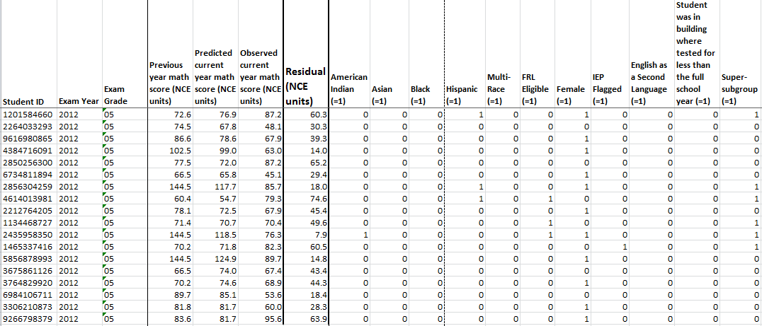
Ex.) Mrs. Smith’s 5th Grade Students
After receiving its 2012 math assessment data, Anytown R-V was able to find growth results for Mrs. Smith’s 5th grade classroom of 18 students. The average NCE of these students’ residuals was 39.3. However, the residuals making up this average are all spread out, ranging from a low of 7.9 to a high of 74.6.
Notes:
-Here is an example of a hypothetical 5th grade class. Within this class there are high residuals such as:
74.6 65.2 63.9
-There are also low residuals such as:
7.9 14.0 14.8
-The average residual for the entire class is 39.3. What this basically says is that for this particular class of students, the average was below expectation.
-But what does that mean?

Slide 110
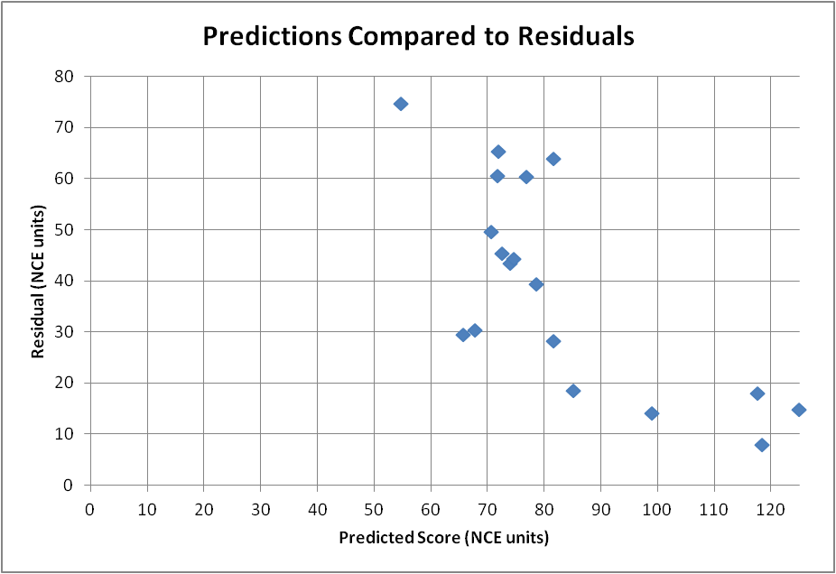
Another Look at Mrs. Smith’s 5th Graders
Predicted to score below average; Actual performance beat prediction
Predicted to score above average; Actual performance beat prediction
Predicted to score below average; Actual performance fell below prediction
Predicted to score above average; Actual performance fell below prediction
All of Mrs. Smith’s students are predicted to score well, but a significant number of them fall short.
Notes:
-It is sometimes helpful to look at the data in a different context. This type of a graph offers a little more comparative information.
-It shows that the majority of students, predicted to score well, in fact don’t.
-But it is important, actually essential, to remember:
*This is only 1 year worth of data. Decisions about Mrs. Smith’s performance as a teacher must be made using multiple measures…meaning student data in addition to observation data and other indicators.
*And when using student data, it must include multiple years.

Slide 111
The Long View
Mr. Doe’s students, on average, beat their score predictions. This result is consistent over a three-year period.
Mr. Doe
Mrs. Smith
Mrs. Smith’s students, on average, fell short of their score predictions. This result is consistent over a three-year period.
Mrs. Smith’s 5th graders, on average, fell below prediction (average NCE less than 50) for three consecutive years. Growth data over multiple years can help reveal patterns. Can Mr. Doe help Mrs. Smith try new strategies to raise her students’ academic achievement?
Notes:
-The “long view” represents multiple years of student data.
-Here we see a pattern of student data from Mrs. Smith’s classes. The data suggests that over time there is consistent performance below expectation of Mrs. Smith’s students.
-What type of support could be provided to Mrs. Smith to help her address this data?
-How might Mr. Doe be used as a resource to teachers given that his student’s performance, on average his above expectation?

Slide 112
Reflections
An average residual tells part of the story:
-Pro: using the average helps keep from putting too much focus on any one student
-Con: if the data are very spread out, the average may not be as meaningful
Graphing the data on an entire classroom at once helps tell the full story
One year of data – was it a fluke?
How does Mrs. Smith compare to Anytown’s other 5th grade teachers?
Notes:
-Review with participants.

Slide 113
Remember…
Multiple years of data such as NCEs are used as one of multiple measures
Notes:
-Review with participants.

Slide 114
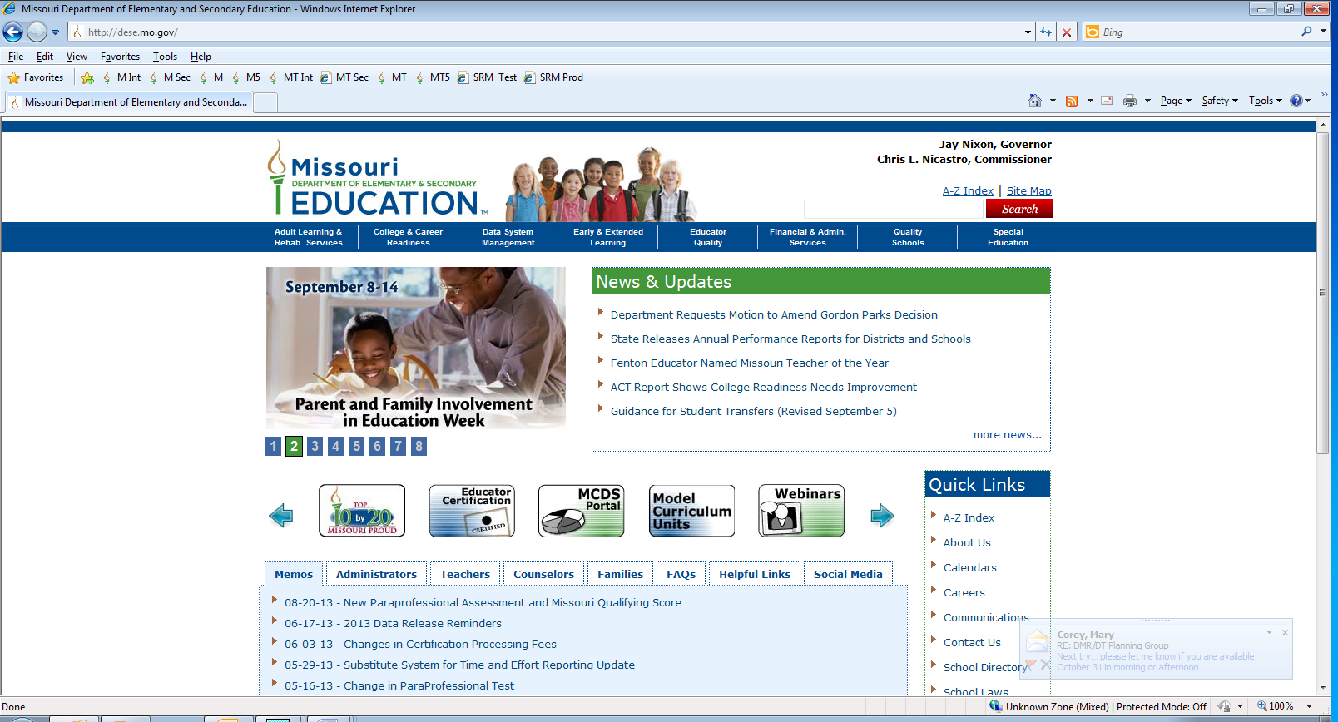
To Access Student Growth Data
Notes:
-From the Departments website http://dese.mo.gov/ -choose MCDS Portal
-The user can also go directly to the site by using this URL: http://mcds.dese.mo.gov/

Slide 115
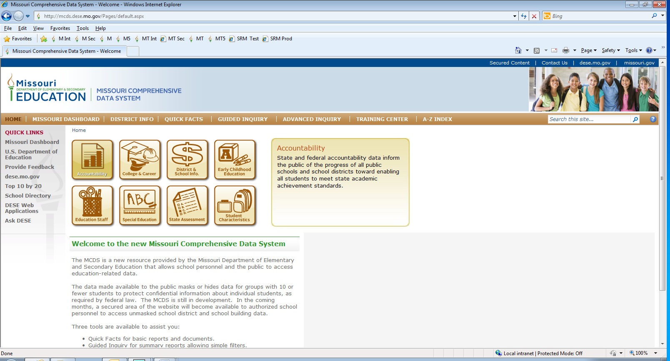
To Access Student Growth Data
Notes:
-The student level data is available via the Secured Content section of the site. To access the Secured Content, the user must logon by clicking on the Secured Content option in the top right hand corner.

Slide 116
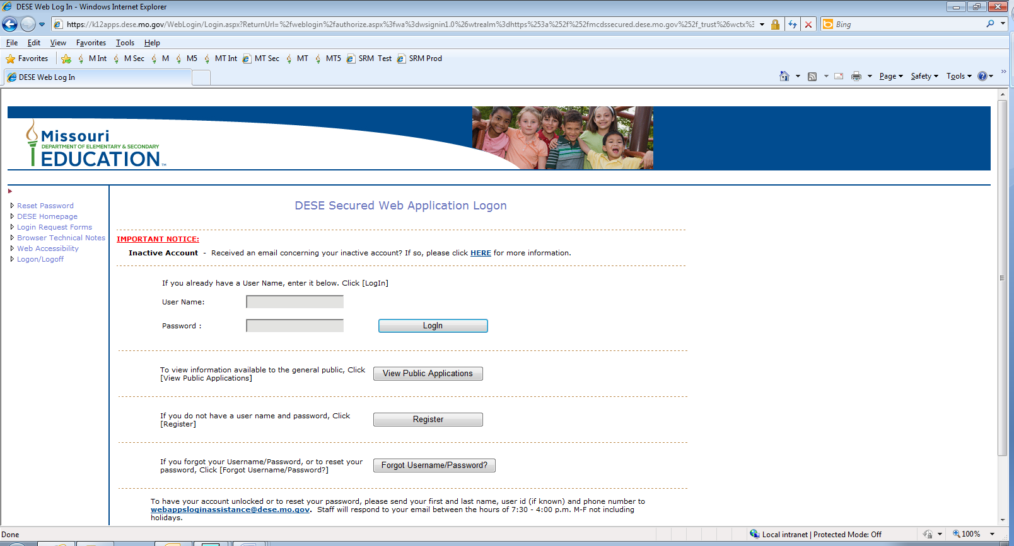
Security: Username & Password
Notes:
-Security is managed at the local district level. The Superintendent or their designee can grant the appropriate staff within the district access to the appropriate data systems.

Slide 117
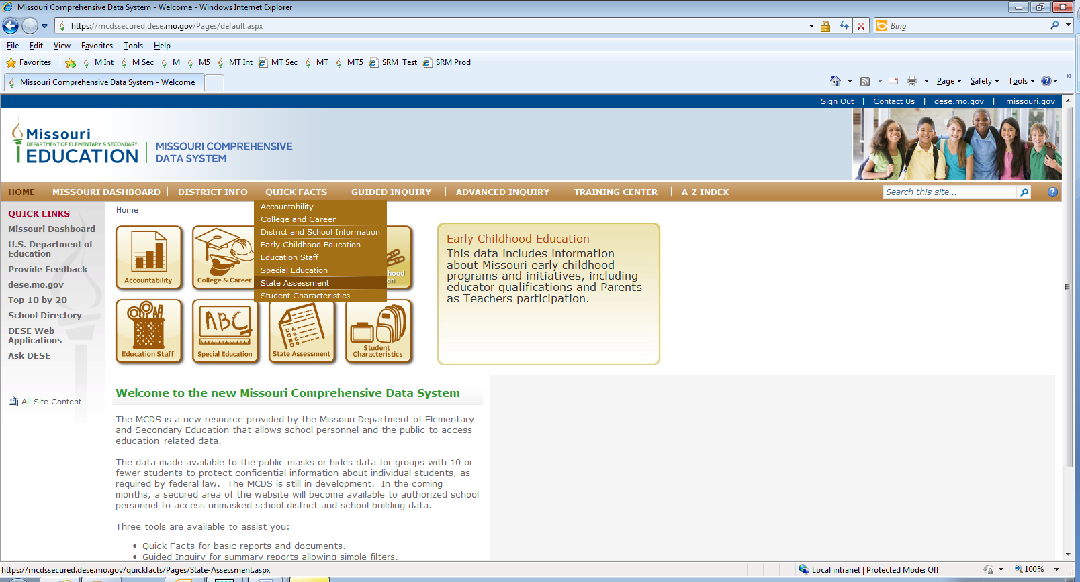
Choose Quick Facts – State Assessment
Notes:
-After logging in with the username and password,
-Choose: Quick Facts and then State Assessment
-Sign out in the upper corner where it says “Sign Out”…

Slide 118
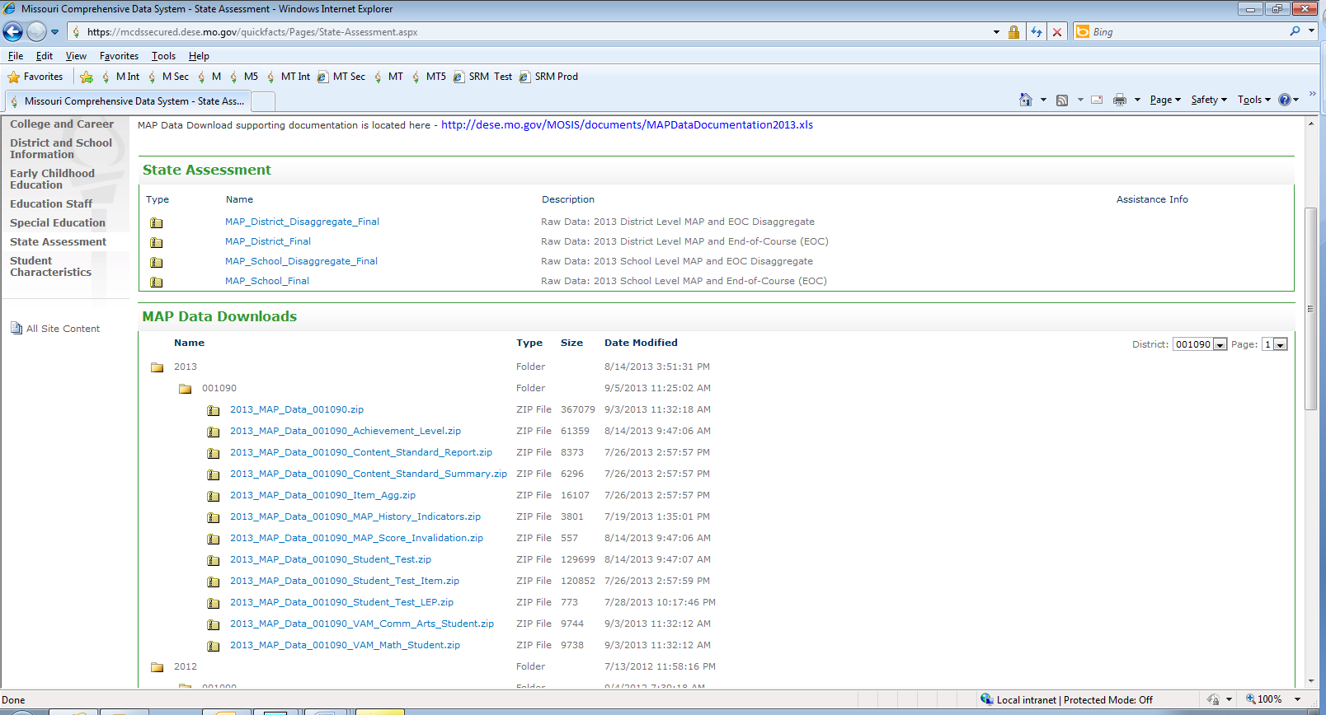
Download Files
Notes:
-The user can download the files. Documentation about the files can be found in the MAP Data Documentation file (MAPDataDocumentation2013.xls).
-Information about the Missouri Growth Model can be found at: http://dese.mo.gov/mogrowthmodel/

Slide 119
An Example Process: Student Learning Objective
Notes:
-Opening slide to Student Learning Objective (one way in which schools can set up a process for teachers to establish and measure student learning goals.)

Slide 120
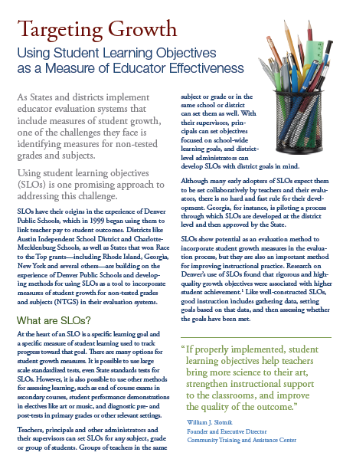
*Article:
Workbook Pg. 11-18
Solo article
# off as “Experts”
1. What are SLOs?
2. SLOs and Teacher Evaluation
3. Challenges
Share most important points from assigned “expert” area!
Notes:
-Prompt participants to:
Solo article
# off as “Experts”
1-What are SLOs?
2-SLOs and Teacher Evaluation
3-Challenges
Share most important points from assigned “expert” area! Handout:
Article

Slide 121
Workbook Pg. 19
Notes:
-Walk through the components of SLO template found in article
(slightly modified)

Slide 122
Notes:
-One manageability consideration sample for System-Wide

Slide 123
Notes:
-Walk through the components of SLO template found in article
(slightly modified)

Slide 124
Let’s Practice! Student Learning Objective
Notes:
-Opening slide to having participants PRACTICE developing an SLO

Slide 125
Notes:
-Participants will use the template provided. Handout: Template

Slide 126
SLO Activity
Teams
Create Example SLO
Mathematics English Language Arts Science Social Studies Music Art Physical Education Business/Technology
As a team, use the Student Learning Objective template to create a “mock” SLO for your content area.
Notes:
-Place signs within room with each content choice title.
-Have participants select which content team they wish to participate. -Ensure participants are evenly divided.
-Prompt small teams to develop sample SLO (they choose content etc.). -Record final product on chart paper. They may choose to only use chart paper versus template…but should mirror template.

Slide 127
Gallery Walk
Post your example SLO on the wall.
# off 1-5
Begin at the station # which matches your assigned number.
Using post-it notes, provide team feedback to the SLO being reviewed.
Notes:
-Gallery Walk: Post your example SLO on the wall.
# off 1-5.
Begin at the station # which matches your assigned number.
Using post-it notes, provide team feedback to the SLO being reviewed.

Slide 128
Action Plan*
Step 3:
Begin to think about how your school will begin to develop, or refine a process where teachers are setting and monitoring measureable student learning goals.
How might this process be connected to your educator evaluation system?
Notes:
-At this time, participants will create an action plan by capturing how they will develop, or refine, a process for SGM. Handout: “Action Plan” document

Slide 129
Getting Started! Student Growth Measures
Notes:
-Steps and considerations for “Getting Started”

Slide 130
Survey Data
Observation
If this is the “End in Mind”… where do we start?
Student growth measures
Other
Notes:
-Reconnect with the “end in mind”…incorporating the use of student growth measures as ONE COMPONENT of an entire educator evaluation system.

Slide 131
1. Determine Measures
What should be measured in each classroom, each course?
What measuring tool will be used in order to:
multiple measures including formative and summative assessments
multiple years of comparable student data
Highlights student growth across two points in time
includes the state assessment where available and appropriate and additional district and school determined assessments
Notes:
-What will be the measured?
-What will be used to measure this learning?

Slide 132
Measures of Growth Examples
Common benchmark and formative district-generated assessments
Peer reviewed performance assessments
Mutually developed student learning objectives by evaluator/teacher
Individualized student growth objectives defined by the teacher
Results on pre-tests and post tests
Student work samples such as presentations, papers, projects, portfolios
Notes:
-Reconnect with the examples.

Slide 133
2. Establish a Process
How can this become a systematic process where teachers become familiar is focusing their own growth and development toward student learning outcomes?
A process where I, as leader, can have meaningful conversation on the impact of teaching on student learning…
*See upcoming slides.
Notes:
-Begin to think about a systematic process where teachers understand how and why everything fits together…

Slide 134
Missouri Educator Evaluation
Identify Quality Indicators End-Year/ Begin-Year
Assess Baseline Performance End-Year/ Begin-Year
Create Educator Growth Plan August-September
Assess Final Performance By March 15
Reflect and Plan March thru End-Year
Apply Plan and Receive Feedback October-February
Protocol

Slide 135
Notes:
-Take the time to refresh in participant’s minds the process shared during the Foundation module.

Slide 136
Missouri Educator Evaluation
Identify Quality Indicators End-Year/ Begin-Year
Assess Baseline Performance End-Year/ Begin-Year
Create Educator Growth Plan August-September
Assess Final Performance By March 15
Reflect and Plan March thru End-Year
Apply Plan and Receive Feedback October-February
Protocol
Notes:
-Visually showing the steps taken within MO Model protocol

Slide 137
Growth Guide
Teacher Growth Guide 7.2
Standard 7: Student Assessment and Data Analysis
Quality Indicator 2: Assessment data to improve learning
Emerging Developing Proficient Distinguished
7E2) The emerging teacher… Demonstrates basic strategies for accessing, analyzing and appropriately using information and assessment results to improve learning activities. |  |  | 7D2) The developing teacher also… Reviews student trend data and growth in learning through a comparison of student work (i.e. pre-/post- test results or similar mechanisms) to inform instructional decisions. |  | 7P2) The proficient teacher also… Uses tools such as rubrics, scoring guides, performance analyses, etc., that clearly identify the knowledge and skills intended for students to acquire in well-defined learning goals. |  | 7S2) The distinguished teacher also… Is able to model and/or share information and expertise with others on the use of a wide variety of assessments and evidence that they improved the effectiveness of instruction.
Professional Frames
Evidence of Commitment N / A Evidence of Practice Collects data information and assessment results for instructional planning and decision-making Evidence of Impact Students engage in learning goals that advance mastery of content |  |  | Evidence of Commitment N / A Evidence of Practice Uses pre and post results or other comparison data to confirm growth in learning and impact future instructional decisions Evidence of Impact Individual students and the whole class advance in their learning |  | Evidence of Commitment N / A Evidence of Practice Regularly uses rubrics, scoring guides and other forms of performance analysis to clearly articulate expectations to students Evidence of Impact Students understand the learning objectives and set personal goals for learning |  | Evidence of Commitment N / A Evidence of Practice Serves as an informal resource to others on the effective use of a wide variety of assessments to improve instruction Evidence of Impact Colleagues improve their use of assessment data to positively impact learning
Score = 0 | 1 | 2 | 3 | 4 | 5 | 6 | 7
Observation
Student Data
Artifact
Notes:
-The highlighted areas represent where evidence is present. The circles represent new evidence to gather to show an increase in the teacher’s performance. Some of that evidence can be gathered in a classroom observation, other evidence gathered by how students performed either as measured by an SLO or state assessment data, and other evidence gathered by what the teacher offers in terms of artifacts to show growth in student performance.

Slide 138
Missouri Educator Evaluation
Identify Quality Indicators End-Year/ Begin-Year
Assess Baseline Performance End-Year/ Begin-Year
Create Educator Growth Plan August-September
Assess Final Performance By March 15
Reflect and Plan March thru End-Year
Apply Plan and Receive Feedback October-February
Protocol
Notes:
-Visually showing the steps taken within MO Model protocol

Slide 139
Notes:
-Take the time to refresh in participant’s minds the process shared during the Foundation module.

Slide 140
Educator Growth Plan* (Missouri Model)
FOCUS Based on evidence generated from the growth guide, determine strengths and a key opportunity for growth. This opportunity for growth then becomes the priority – the FOCUS – for your growth plan. | 2. GOAL Create a goal statement addressing the FOCUS. This goal statement should include these essential qualities: specific, measureable, achievable, relevant, and timely. What will be the result indicators?
3. STRATEGY Describe the specific strategy(ies) to be implemented that will address the goal statement. This strategy should provide the best plan for effectively addressing the FOCUS and include clear action steps and timeline. | 4. RESULTS What was the outcome of the strategy? Based on progress monitoring, provide the data that supports that the outcome of the strategy has effectively addressed the FOCUS.
Notes:
-Educator Growth Plan (reconnecting to visual)

Slide 141
Notes:
-Take the time to refresh in participant’s minds the process shared during the Foundation module.

Slide 142
Notes:
-Walk through the components of SLO template found in article
(slightly modified)

Slide 143
Missouri Educator Evaluation
Identify Quality Indicators End-Year/ Begin-Year
Assess Baseline Performance End-Year/ Begin-Year
Create Educator Growth Plan August-September
Assess Final Performance By March 15
Reflect and Plan March thru End-Year
Apply Plan and Receive Feedback October-February
Protocol
Notes:
-Visually showing the steps taken within MO Model protocol

Slide 144
Missouri Educator Evaluation
Identify Quality Indicators End-Year/ Begin-Year
Assess Baseline Performance End-Year/ Begin-Year
Create Educator Growth Plan August-September
Assess Final Performance By March 15
Reflect and Plan March thru End-Year
Apply Plan and Receive Feedback October-February
Protocol
Notes:
-Visually showing the steps taken within MO Model protocol

Slide 145
Growth Guide
Teacher Growth Guide 7.2
Standard 7: Student Assessment and Data Analysis
Quality Indicator 2: Assessment data to improve learning
Emerging Developing Proficient Distinguished
7E2) The emerging teacher… Demonstrates basic strategies for accessing, analyzing and appropriately using information and assessment results to improve learning activities. |  |  | 7D2) The developing teacher also… Reviews student trend data and growth in learning through a comparison of student work (i.e. pre-/post- test results or similar mechanisms) to inform instructional decisions. |  | 7P2) The proficient teacher also… Uses tools such as rubrics, scoring guides, performance analyses, etc., that clearly identify the knowledge and skills intended for students to acquire in well-defined learning goals. |  | 7S2) The distinguished teacher also… Is able to model and/or share information and expertise with others on the use of a wide variety of assessments and evidence that they improved the effectiveness of instruction.
Professional Frames
Evidence of Commitment N / A Evidence of Practice Collects data information and assessment results for instructional planning and decision-making Evidence of Impact Students engage in learning goals that advance mastery of content |  |  | Evidence of Commitment N / A Evidence of Practice Uses pre and post results or other comparison data to confirm growth in learning and impact future instructional decisions Evidence of Impact Individual students and the whole class advance in their learning |  | Evidence of Commitment N / A Evidence of Practice Regularly uses rubrics, scoring guides and other forms of performance analysis to clearly articulate expectations to students Evidence of Impact Students understand the learning objectives and set personal goals for learning |  | Evidence of Commitment N / A Evidence of Practice Serves as an informal resource to others on the effective use of a wide variety of assessments to improve instruction Evidence of Impact Colleagues improve their use of assessment data to positively impact learning
Score = 0 | 1 | 2 | 3 | 4 | 5 | 6 | 7
Notes:
-The follow-up assessment , using the same 7.2 growth guide as the initial assessment, reveals the following evidence
-The teacher has been observed and has received feedback on her use of rubrics and scoring guides with her students.
-The teacher has also been observed and received feedback on how she has used the rubrics and scoring guides to help students more clearly understand the specific expectations of the learning content.
-Also, some measure has been offered demonstrating students growth in their understanding of a learning objective. Again, this can be demonstrated using a wide variety of different measures. For example, the teacher might show samples of student projects or presentations;
-Perhaps the teacher shows pre and post tests showing the growth students have made in their understanding of a particular concept or maybe even data from the state’s assessment using the new student growth data
-In addition, examples of student goals for learning provides evidence that students are able to set these goals and work towards achieving them.
-Given the evidence, it is determined that the teacher has achieved a follow-up score of 6

Slide 146
Educator Growth Plan* (Missouri Model)
FOCUS Based on evidence generated from the growth guide, determine strengths and a key opportunity for growth. This opportunity for growth then becomes the priority – the FOCUS – for your growth plan. | 2. GOAL Create a goal statement addressing the FOCUS. This goal statement should include these essential qualities: specific, measureable, achievable, relevant, and timely. What will be the result indicators?
3. STRATEGY Describe the specific strategy(ies) to be implemented that will address the goal statement. This strategy should provide the best plan for effectively addressing the FOCUS and include clear action steps and timeline. | 4. RESULTS What was the outcome of the strategy? Based on progress monitoring, provide the data that supports that the outcome of the strategy has effectively addressed the FOCUS.
Notes:
-Visually showing the steps taken within MO Model protocol

Slide 147
Notes:
-Visually showing the steps taken within MO Model protocol

Slide 148
Specific teacher information
General
Feedback on
Standards 1-7
* Meets Expectation
* Growth Opportunity
* Area of Concern
* Comments
Notes:
-The summative evaluation form provides documentation in a variety of areas.
-The first page and a half of the summative evaluation form provides an overview of the effectiveness of the teacher looking across all nine standards
-Each standard is listed with summary statements. The statements represent a very broad description drawn from the categories of commitment, practice and impact. They are listed as a type of general description of each of the 9 standards. For each standard, three options are provided:
Area of Concern – checking this box for a standard will result in an improvement plan for this standard meaning that growth in this area is both necessary and required. Details and a rationale are provided in the comments section.
Growth Opportunity – checking this box for a standard might possibly result in an indicator from this standard being selected in the following year as an opportunity for growth and documented in the next year’s Educator Growth Plan
Meets Expectation – checking this box for this standard indicates that performance in this area meets the overall expectation of the administrator/district at the present time
-Note: the comment box provided below each standard provides opportunity to offer the rationale for the rating as well as to note exemplary performance in this particular area.

Slide 149
General
Feedback on
Standards 8-9
Specific
Feedback on
Areas of Focus
* Indicator Rationale
* Baseline Rating
* Goals and Results
* Follow-Up Rating
Notes:
-Performance assessment is provided at the top of the 2nd page on standards 8 and 9
-The summative evaluation form also captures information about the teacher’s performance on selected indicators
-This section of the summative evaluation form focuses on the growth opportunities presented through the selected indicators.
Indicator and Rationale-document the specific indicator(s) that were selected and the reason this was a growth opportunity for the teacher.
Baseline Rating-indicate the initial rating achieved for each selected indicator.
Goal-summarize the goal that was created to address the growth opportunity.
Results-describe the outcomes of implementing the strategy and determine whether the focus was adequately addressed.
Follow-Up Assessment-indicate the follow-up rating achieved for each selected indicator.
*Keep in mind that this information has already been documented on the Educator Growth Plan.

Slide 150
Performance
Determination
Chart
Performance
Rating
General
Overall
Comments
Recommendation Signatures
Notes:
-The final page of the Summative Evaluation Form provides an overall rating for the teacher. This section is completed as follows:
*Years in Position – determine the number of years the teacher has been in the current evaluated position (Note: the purpose for “in position” is to allow for reassignment of teachers to different grade levels/positions without adversely affecting performance ratings)
*Select one of the effectiveness ratings based on the following criteria:
-An Ineffective Rating if there are multiple areas of concern across the 9 standards, OR An average of the follow-up assessment scores on the selected indicators fall into the indicated range
-A Minimally Effective Rating if there is 1 area of concern across the 9 standards, OR an average of the follow-up assessment scores on the selected indicators fall into the indicated range
-An Effective Rating if there are no areas of concern across the 9 standards, AND an average of the follow-up assessment scores on the selected indicators fall into the indicated range
-A Highly Effective Rating if there are no areas of concern across the 9 standards, AND an average of the follow-up assessment scores on the selected indicators fall into the indicated range.
*Complete the statement of effectiveness for the teacher, add comments regarding data on performance gathered through the evaluation process throughout the year and provide a recommendation regarding employment.

Slide 151
3. Determine how staff can be educated, modeled and supported in this defined process?
How can we start simplistically and focus on one area so that staff are not overwhelmed with the process?
If using the Student Learning Objective format, how might the staff be modeled how to construct high quality SLOs?
Notes:
-How will staff be educated, modeled, and supported about identified process? This will take some planning by a leadership team.

Slide 152
Notes:
-SLOs can range in quality…how can leaders set up their teachers successfully?

Slide 153
Recommendations from MO Schools Sub-Pilot Group (2012-2013)
Common Theme #1: Create a collaborative, trusting culture where teachers are trained to look at data, use quality instructional strategies and construct high quality assessments.
Common Theme #2:
Develop common benchmark assessments utilizing a pre- and post-assessment structure on important (essential) standards.
Common Theme #3:
Evaluators receive specific training on how to use student growth measures in the evaluation process. SLO…get started?
Notes:
-Sub-Pilot Group identified 3 common themes/recommendations for school districts in their preparation for implementation.

Slide 154
Considerations
The Missouri Growth Model and Student Learning Objectives offer a few of many opportunities for schools to address Student Growth Measures as their own comprehensive evaluation systems are under development, refinement, or replacement.
Share what you are thinking and doing in your own schools with other schools beyond your borders. Develop a network of support by contributing, discussing, piloting, implementing, and assessing your efforts and the efforts of others.
Notes:
-Considerations as part of closure continued

Slide 155
Resources
DESE "Guidelines for Use of Student Growth Measures in Educator Evaluation"...
a. Are found in the "Essential Principles of Educator Evaluation" section of the Missouri Educator Evaluation
System which can be accessed through the DESE website at www.dese.mo.gov...
b. Offer a solid start for understanding the extreme importance of Student Growth Measures within local school district educator evaluation systems as of 2014-15. This is a must read.
c. Provide numerous "References and Resources," "State Resources,“ and "Additional Sample SLOS from other states."
Notes:
-Resources

Slide 156
Resources
Please go beyond the contents of this presentation and DESE's "Guidelines for Use of Student Growth Measures in Educator Evaluation" for more information to expand your knowledge and understanding of the appropriate use of measures of student growth in learning.
Workbook Pg. 20-27
Notes:
-Resources Continued

Slide 157
EES Guideline: Student Growth Measures
http://dese.mo.gov/eq/edeval.htm
Workbook Pg. 28
Notes:
-Hyperlink provided for Missouri EES Guideline: Student Growth Measures
-Informs participants on how they can access this information.

Slide 158
2013-2014 Training Roadmap*
Educator Evaluation Training
Building a Foundation
Probationary
Evaluator Training and Feedback
Student Growth Measures
Notes:
-Closing visual…and another glimpse of the additional training modules.

Slide 159
Intended Outcomes
Determine current reality and foundational elements necessary in the use of student growth as a component of a comprehensive educator evaluation system
Identify the key components that can be used as student growth measures within educator evaluation system.
Develop a sample Student Learning Objective (SLO) using the professional growth plan
Create a plan for educating/modeling to staff how to create a SLO
Notes:
-As part of closure, review Intended Outcomes to recap content of training session.

Slide 160
Contact Us
www.dese.mo.gov
Email: communications@dese.mo.gov
Phone: 573-751-3469
The Department of Elementary and Secondary Education does not discriminate on the basis of race, color, religion, gender, national origin, age, or disability in its programs and activities. Inquiries related to Department programs and to the location of services, activities, and facilities that are accessible by persons with disabilities may be directed to the Jefferson State Office Building, Office of the General Counsel, Coordinator – Civil Rights Compliance (Title VI/Title IX/504/ADA/Age Act), 6th Floor, 205 Jefferson Street, P.O. Box 480, Jefferson City, MO 65102-0480; telephone number 573-526-4757 or TTY 800-735-2966; fax number 573-522-4883; email civilrights@dese.mo.gov.

