Slide 1
The Great Chicago Fire

Slide 2
Time line
October 7, 1871 Fire breaks out a lumber mill on the Near West Side of Chicago
October 8, 1871
Morning The October 7 fire is extinguished; three tons of hay delivered to O’Leary barn
7:30-8:00pm O’Leary family retires for the night
8:45pm O’Leary’s neighbor notices fire in O’Leary barn
10:30pm Fire officially reported as “out of control”
11:30pm Fire jumps south fork of Chicago River

Slide 3
Time Line con’t
October 9, 1871
1:30am State Street bridge catches fire
2:30am Courthouse bell crashes to the floor; fire jumps main branch of Chicago River
11:00pm Fire approaches Fullerton Avenue; light rain begins to fall
October 10
3:00am Rain strengthens, extinguishing the fire

Slide 4
Facts about Chicago
In the 1870s the population was 300,000, which was 10 times as much as in 1850.
In 1870 Chicago was the leading in the lumber trade.
The city also had cattle and grain trade as part of their commerce.
Railroads were very important during that time period.

Slide 5
Causes of the Fire
Wind- This provided oxygen and southwest winds that fanned the flames.
Petroleum and Pollution in the river from the lumber yards.
Wood that the buildings were made from.
Firemen were unavailable because when they originally saw the fire they thought it was from the lumber mill, which they put out the night before. Once they realized it was not from that it was too late.

Slide 6
Impact of the Fire
300 were presumed dead
100,000 were homeless
17,500 buildings were destroyed
$200-$400 million in property damage

Slide 7
Homework
After looking at the devastation that the Chicago fire did please go home and develop a Fire Plan with your family.
Draw a floor plan of your house and then with a red crayon or marker draw a line from your bedroom to the primary exit. Then use a green crayon or marker to make a Plan B escape.
Then assign a meeting place once your family is safely outside.
On the floor plan write down where your smoke detectors are located.
Finally create a mock fire drill and time it.
For further information go to www.nfpa.org

Slide 8
How do we know what happened?
Eyewitness accounts
Newspaper articles

Slide 9
Introduction
There are many stories that have been told about the Great Chicago Fire. Now it will be your group’s job to retell those stories to the class. Tell us what their viewpoint was and how it effected them. You will be showing us where on the map that the authors were describing.
Finally, be able to answer the following questions:
Why was it so important for them to write to another person about the fire?
Why did they add so much detail?
How can I apply this in my letter writing?

Slide 10
Jobs
You will have a group of four members that will consist of a recorder, surveyor, reporter, and a Chief of State.
Recorder will be the one who recorder your thoughts and findings on the Written Document Analysis Worksheet.
Surveyor will locate the buildings on the Chicago map.
Reporter will report the findings to other groups.
Chief of Staff will read the stories out loud and help lead the group in discussion making sure everyone is on task.
While you are reading through the stories of the Great Chicago Fire fill out the Written document Analysis Worksheet.

Slide 11
Stories
Losses by the Fire by Elias Colbert
Podcast Eight Forty-Eight
Eyewitness Letter by Mary Kehoe
Eyewitness Letter by James W. Milner
Eyewitness Letter by Mrs. William Blair’s
Newspaper Account by the Tribune
Pages 57-60 “Fire Sir,” from Chicago History for Kid
Notes:
You don’t have to use all sources but it would be handy to only have four in a group.

Slide 12
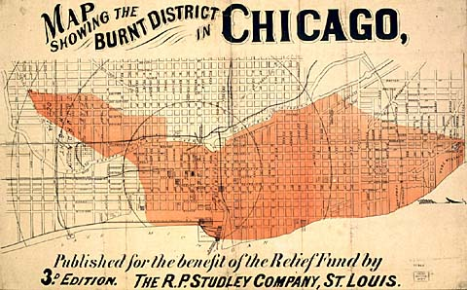
Map of Chicago Fire

Slide 13
What happened after the fire?
Chicago began to rebuild buildings using new architecture.
Social programs were developed by Jane Addams, George Pullman, and others.
Population grows to one million by 1890.
“L” train begins operation in 1892.
Chicago World’s Fair in 1893.

Slide 14
Activity
Once you have looked through one of these many accomplishments of Chicago write a news article that tells how this help make Chicago great!
Make sure you tell the impacts of accomplishment.
The date, time, and who started it.
Who did this effect?

Slide 15
References
http://www.archives.gov/education/lessons/worksheets/document.html
http://www.chicagohistory.org/fire/ruin/losses.html
http://www.wbez.org/Content.aspx?audioID=38900
http://www.chicagohs.org/fire/witnesses/kehoe.html
http://www.chicagohs.org/fire/witnesses/milner.html
http://www.chicagohistory.org/fire/conflag/tribune.html
Hurd, Owen (2007). Chicago History for Kids.

