Slide 1
THOMAS ALVA EDISON
“Napoleon of Science”
“Wizard of Menlo Park”

Slide 3
Discussion Questions:
Why is Edison considered one of the 20th century’s most influential persons?
How did Edison’s inventions change the world?
How did WWI inspire Edison to create additional inventions?
What part did practicality play in Edison’s inventions?

Slide 4
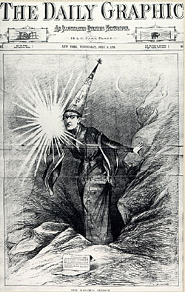
More Than a Light Bulb
System of incandescent lighting
Invented system to record and replay sound
Motion pictures
Improvements on telegraphs & telephones
Using concrete in construction
Storage batteries
1,093 patents

Slide 5
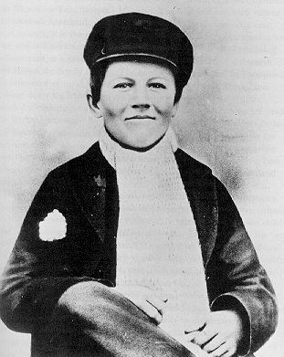
YOUTH
Home-schooled
Showed intelligence and drive at an early age
Hard of hearing—lost hearing at age 12
Age 15 printed and published his own newspaper, “The Weekly Herald”

Slide 6
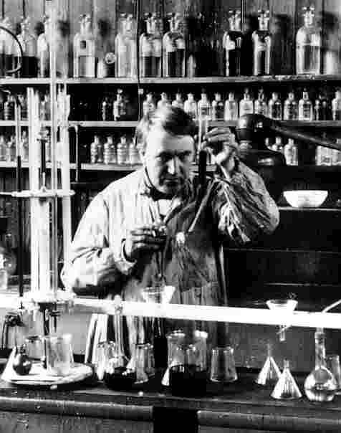
Changing Times
What changes were happening
during Edison’s life?
Growth of transportation and
information networks
Giant corporations
Increased consumer
consumption

Slide 7
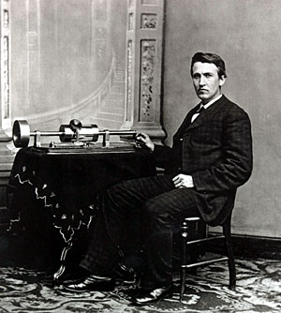
Phonograph
1877 Menlo Park—first phonograph developed
Used tin foil wrapped around a cylinder as recording surface
Recorded nursery rhyme, “Mary Had a Little Lamb”

Slide 8
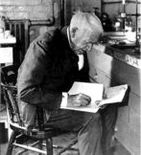
Criticisms
New York Times, March 25, 1878
Something ought to be done to Mr. Edison …Recently he invented the phonograph, a machine that catches the lightest whisper of conversation and stores it up…This machine will eventually destroy all confidence between man and man, and render more dangerous than ever woman’s want of confidence in woman.

Slide 9
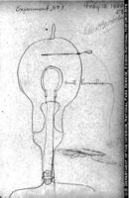
Incandescent Lighting
Electric lighting was not new
Edison developed the incandescent light and an electrical system to make light practical, economical, and safe
1882 1st commercial power station

Slide 10
Kinetoscope
Demonstrated motion pictures in 1891
Filmed movies in the “Black Maria”, a building built and designed for motion picture production
Man looking at a kinetoscope

Slide 11
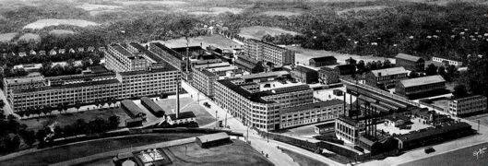
West Orange Lab, New Jersey
Established in 1887, the lab was the world’s first research and development lab.
“The best equipped and largest laboratory extant and the facilities superior to any other for rapid and cheap development of an invention.” Edison

Slide 12
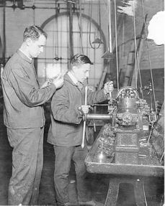
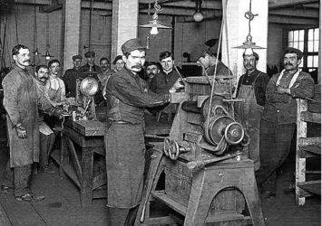
Factory Workers
Edison held racial stereotypes of his day. However, he did employ Serbians, Englishmen, Germans, Swedes, Slavs, and Jews. Women had no place in his laboratory.

Slide 13
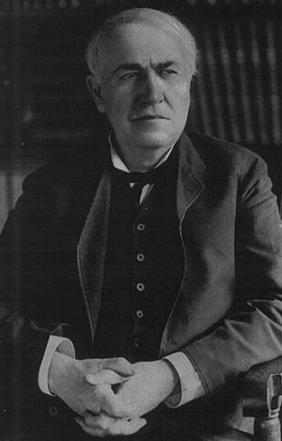
Edison “invented inventing”
Knew how to be self-promoting
Recognized value of patents,
copyrights, and trademarks
Invention was more than just
a good idea
Menlo Park and West Orange were
his invention factories
Edison became a symbol of American ingenuity

Slide 14
Technology and Social Change
What determines success or failure of an invention?
Does technology shape society?
Does society shape technologies to be developed?

Slide 15
Edison’s Personal Life:
Thomas Alva Edison was born to Sam and Nancy Edison on February 11, 1847, in Milan, Ohio
1871,married a former employee, Mary Stilwell, on Christmas Day. Their first child, Marion, was born in February 1873, followed by a son, Thomas, Jr., born on January 1876. A third child, William Leslie was born in October 1878.

Slide 16
Edison’s Life continued:
Edison's wife, Mary, died on August 9, 1884, possibly from a brain tumor. Edison remarried Mina Miller on February 24, 1886.
Edison and Mina had their own family: Madeleine, born in 1888; Charles in 1890; and Theodore in 1898.
He died on October 18, 1931. " In tribute to Edison, electric lights in the United States were dimmed for one minute on October 21, 1931, a few days after his death.

Slide 17
Conclusion
Edison was an inventor, successful manufacturer and businessman, marketing his inventions to the public. Formed business liaisons, partnerships, and corporations.
Edison credited his mother for his success. "My mother was the making of me. She was so true, so sure of me, and I felt I had some one to live for, some one I must not disappoint."

Slide 18
Conclusion continued
Edison was a hard worker, working at times twenty hours a day. He said, “Genius is one percent inspiration and 99 percent perspiration.”
Edison’s nicknames, “Wizard of Menlo Park” and “Napoleon of Science” were well deserved.

Slide 19
Citations
http://xroads.virginia.edu/~class/am485_98/brady/Edison/tale.html
http://edison.rutgers.edu/webimages/wizard.jpg
http://edison.rutgers.edu/tinfoil.htm
http://obits.eons.com/tribute/gallery/9215?section=thomas-edison-section&category=thomas-edison
http://www.nps.gov/archive/edis/edifun/edifun_hschool/techandimpact.htm
http://www.nps.gov/archive/edis/edisonia/tae_bio.html
http://memory.loc.gov/ammem/edhtml/edbio.html#N_1_
http://fi.edu/franklin/inventor/edison.html

Slide 20
Citations
Thomas Edison and Modern America, Theresa M. Collins and Lisa Giteman, Bedford/St. Martin’s, 2002.
http://streaming.discoveryeducation.com/search/assetDetail.cfm?guidAssetID=685D100D-E1EE-4EDA-99F4-4BDE8DEB8B51

